Slide 1

Glimpses
(Classmate creations only)
HR1981 45th Reunion
Created and Produced by:
Dan Scherlis
and
Kate Elliott Scherlis

Slide 2

Classmate Authors’
Book Covers from
Authors Salon
“81”
Poster by Patric M. Verrone

Slide 3
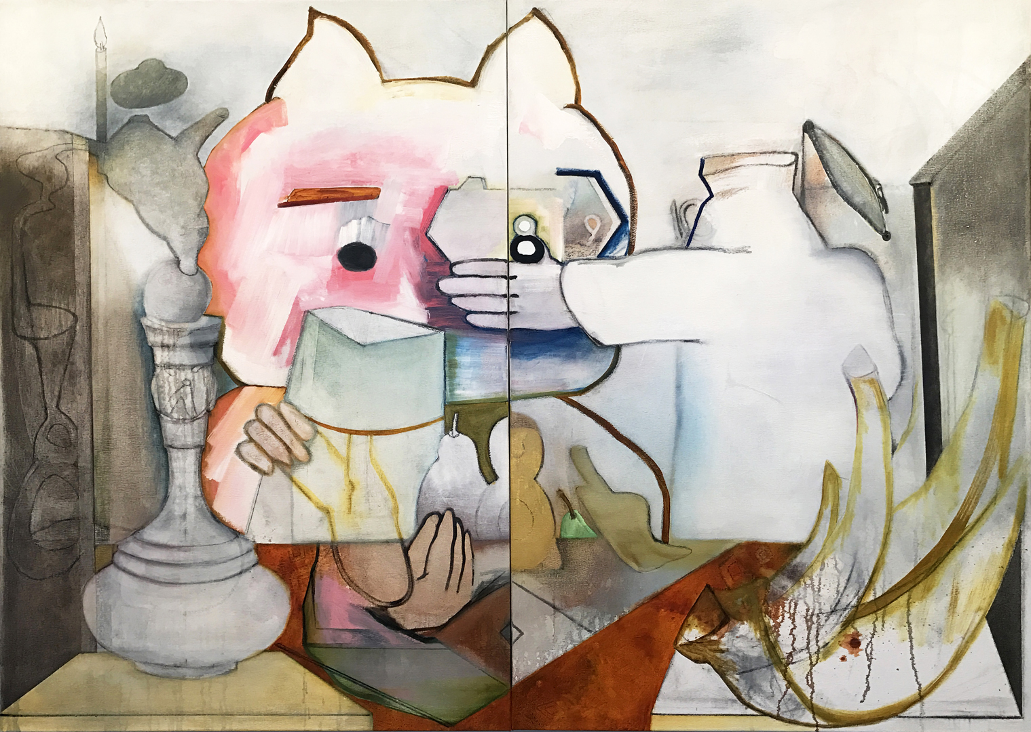
Jennifer Amadeo-Holl
Why Was 6 Afraid of 7 oil on linen

Slide 4
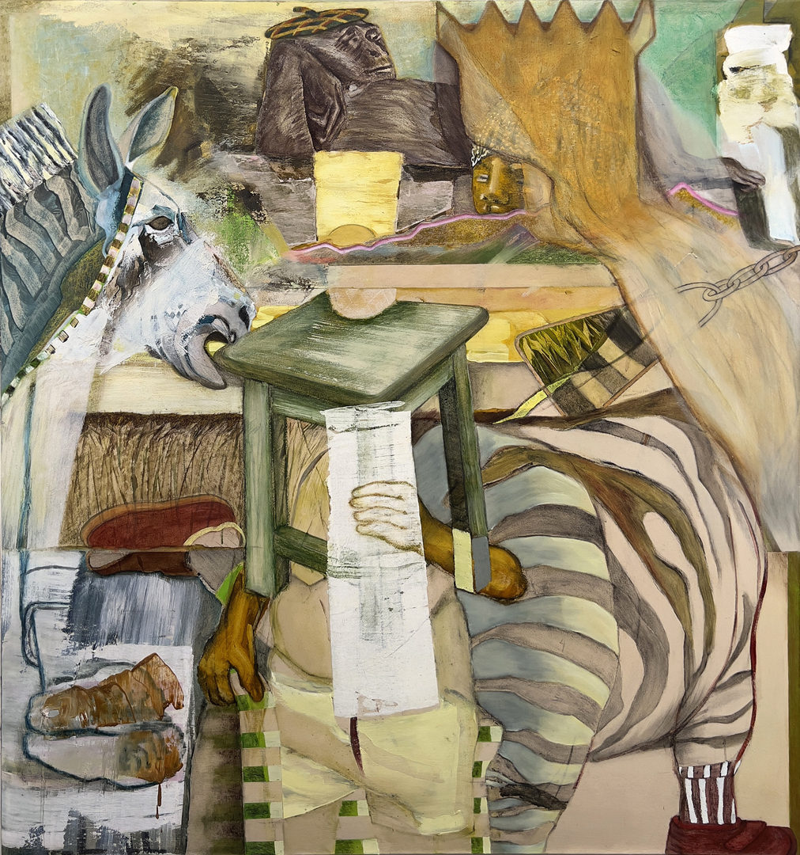
Jennifer Amadeo-Holl
A Leg to Stand On | History + Hope oil on canvas

Slide 5
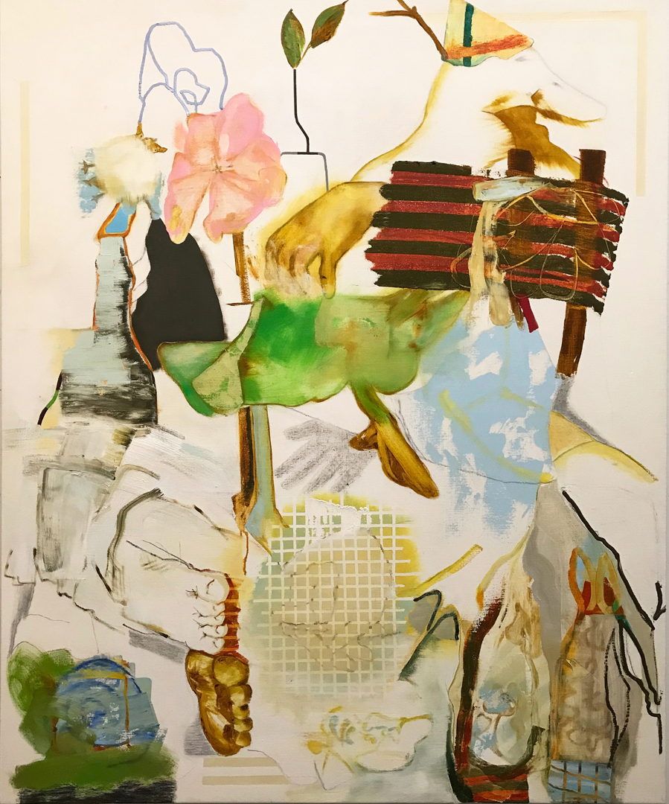
Jennifer Amadeo-Holl
Steady as She Goes oil on linen

Slide 6

Photograph by Colin Ball: Connemara Reflects

Slide 7

Photograph by Colin Ball: Derryclare Reflects

Slide 8
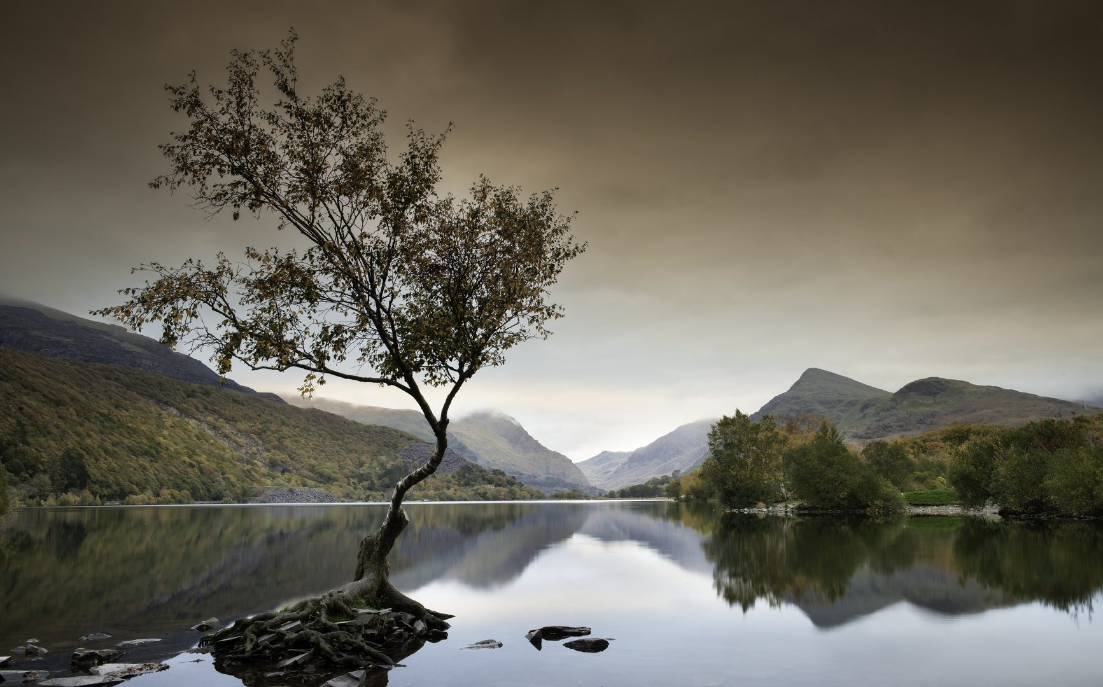
Photograph by Colin Ball: Llanberis Tree

Slide 9
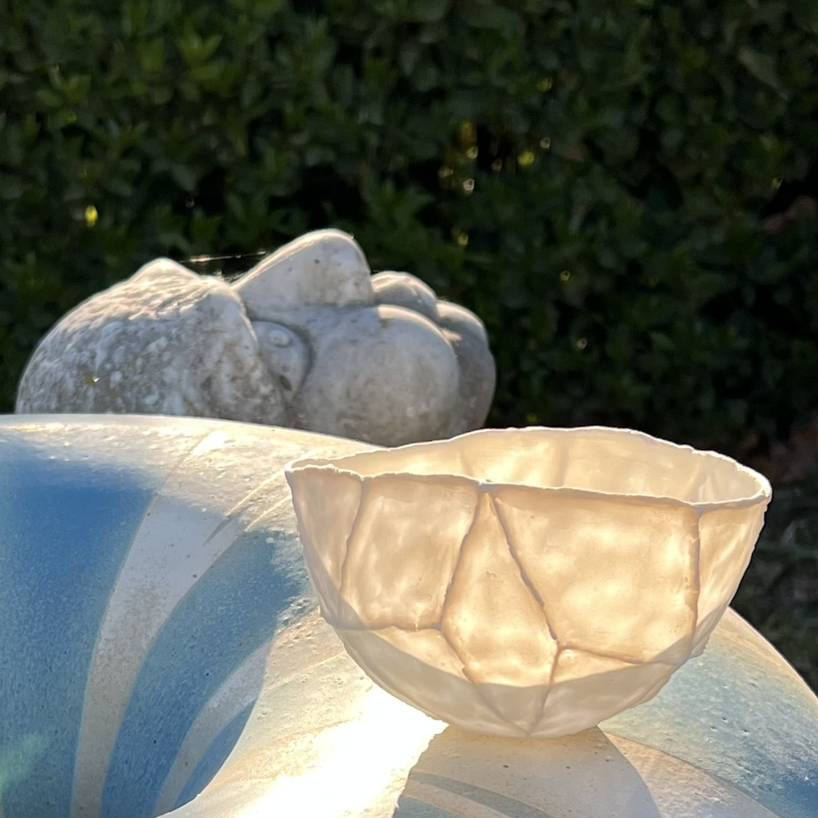
Ceramic by
Andrea Robinson

Slide 10
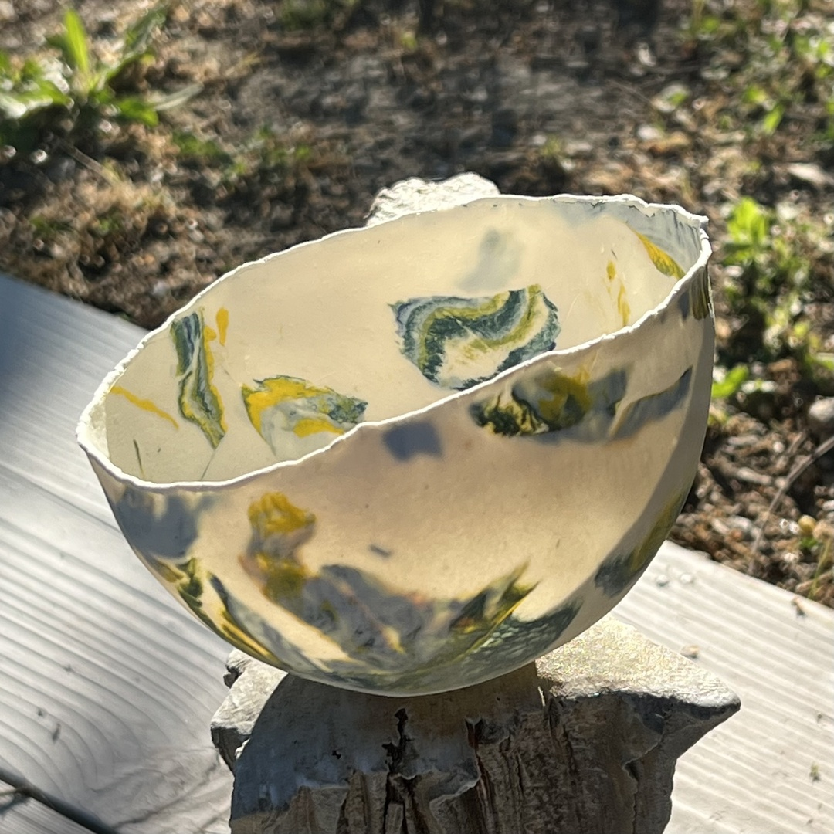
Ceramic by
Andrea Robinson

Slide 11
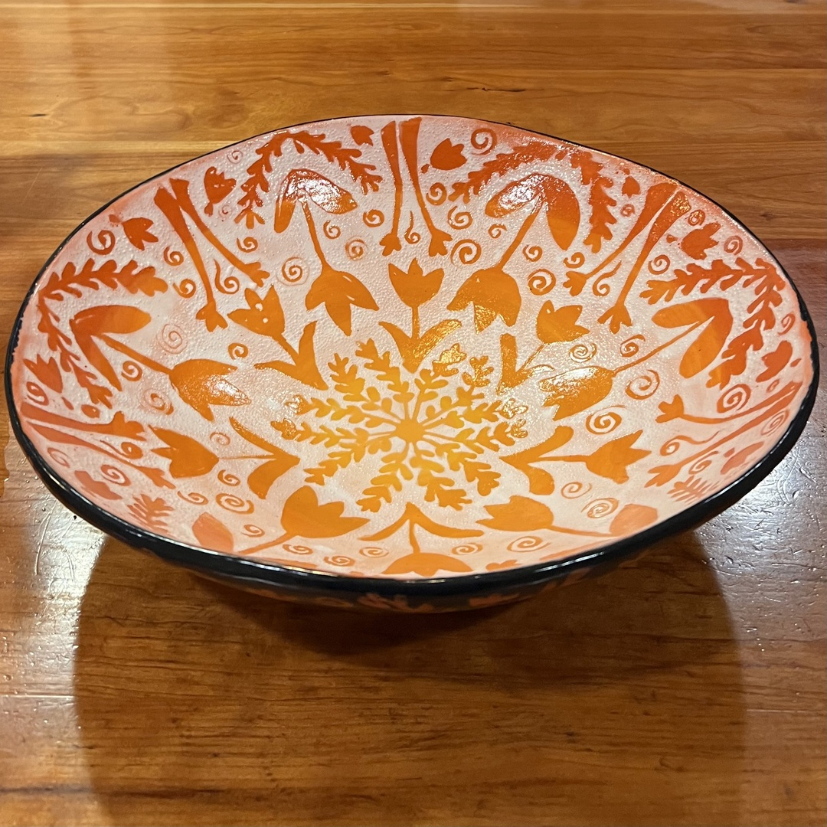
Ceramic by
Andrea Robinson

Slide 12
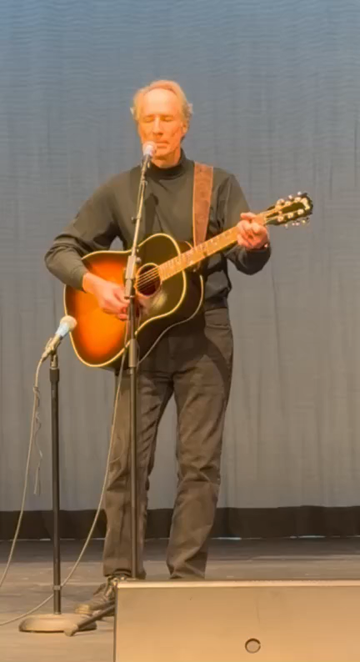
Scott MacLeod
Angel From Montgomery

Slide 13
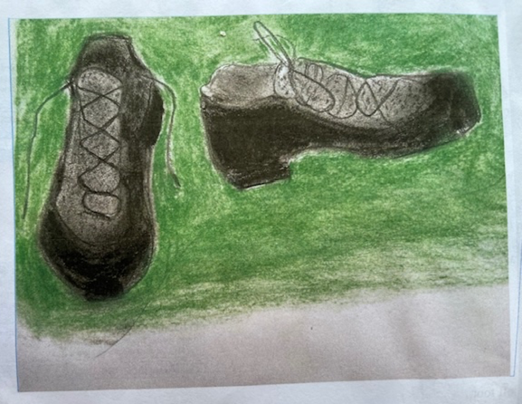
Ode to My Capezio Dance Sneakers
You support my high arches, cushion them, pad toe and heels, against the concrete streets.
You’re easy to slip on and kick off.
In you, I walk steadily through the vagaries of the day—the upsets and little victories…
Complete poem at KimBendheim.com
Drawing & Poem by Kim Bendheim
My Capezios

Slide 14
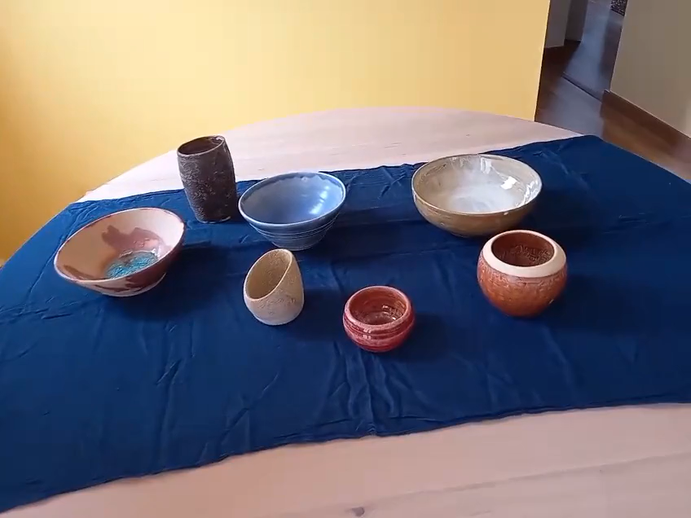
Ceramics by
Fernando Vidal
Recent Experiments with Glazing

Slide 15
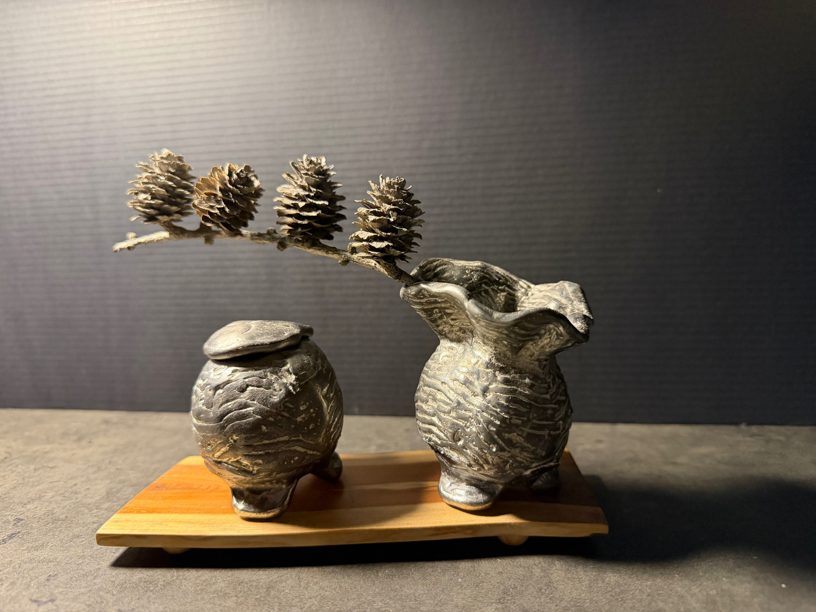
Sculpture by Tim Higginson
pewter from wax original – TeaSculpture.com

Slide 16
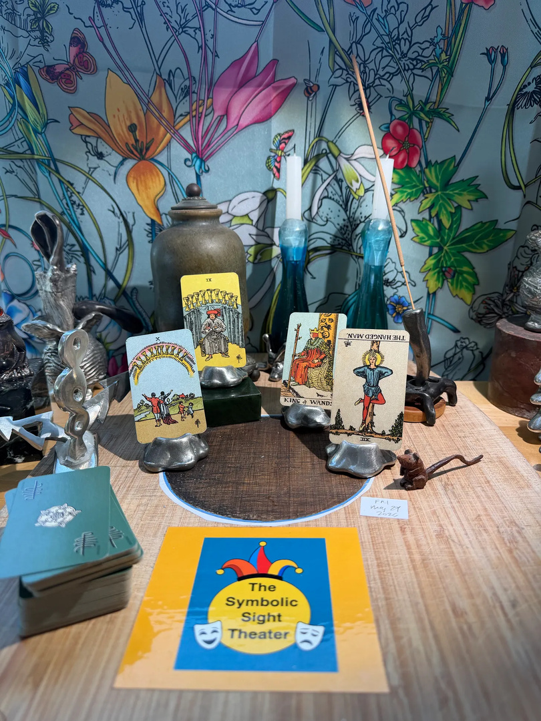
Tim Higginson
Text plays based on Tarot cards
SymbolicSightTheater.substack.com

Slide 17
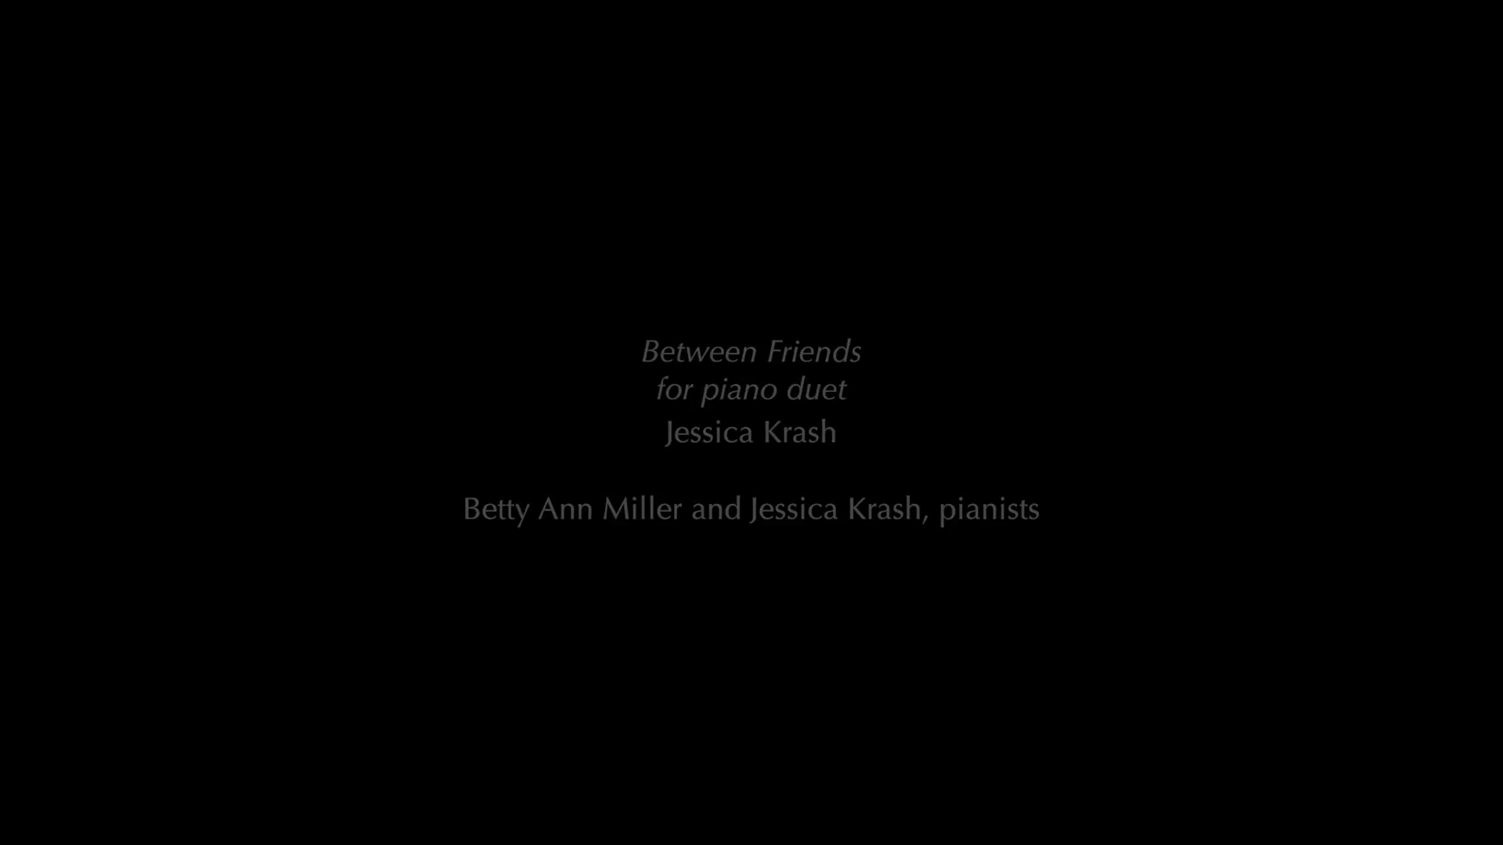
Composed & Performed by Jessica Krash
From Between Friends (performed with Betty Ann Miller, in white)

Slide 18
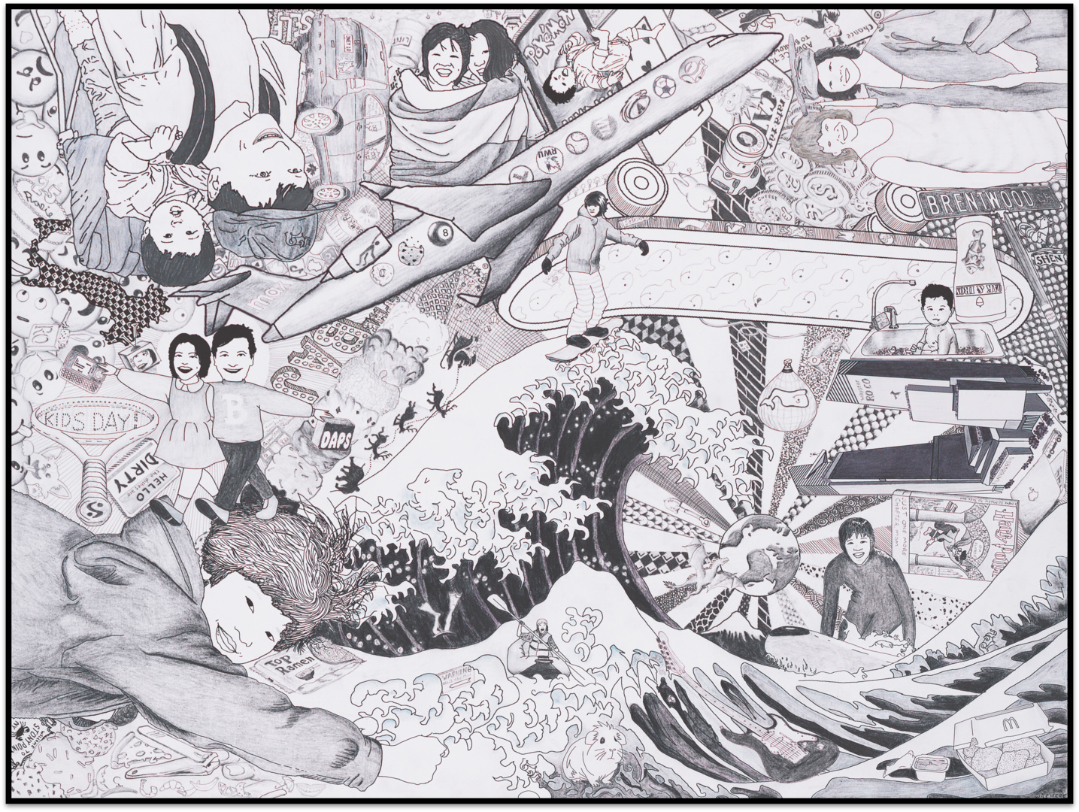
Andy “Bub” Shen mixed-media ink & graphite
2024
Stream of Consciousness, Daughter Rosie Shen

Slide 19
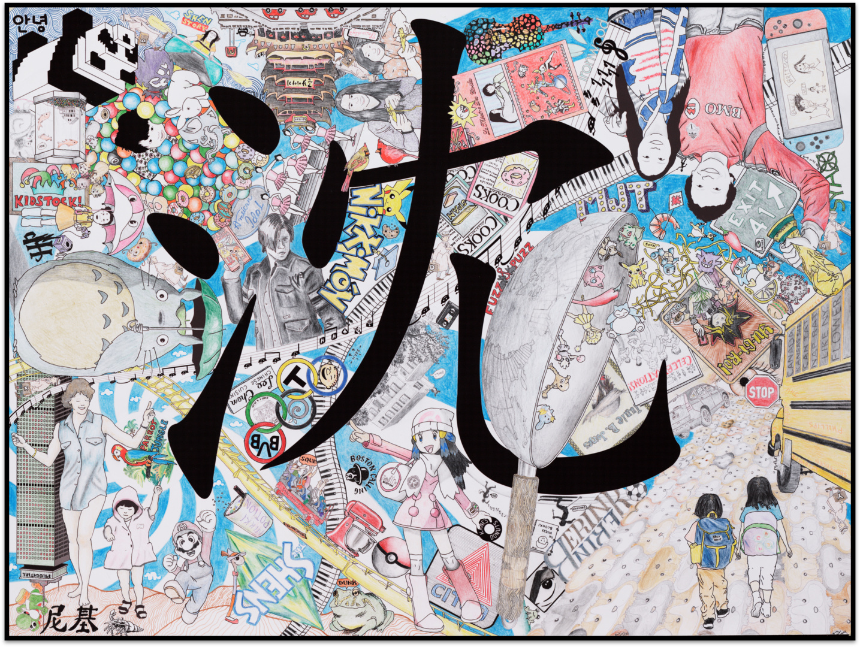
Andy “Bub” Shen mixed-media ink, graphite, & colored pencil
2025
Stream of Consciousness, Daughter Nikki Shen

Slide 20
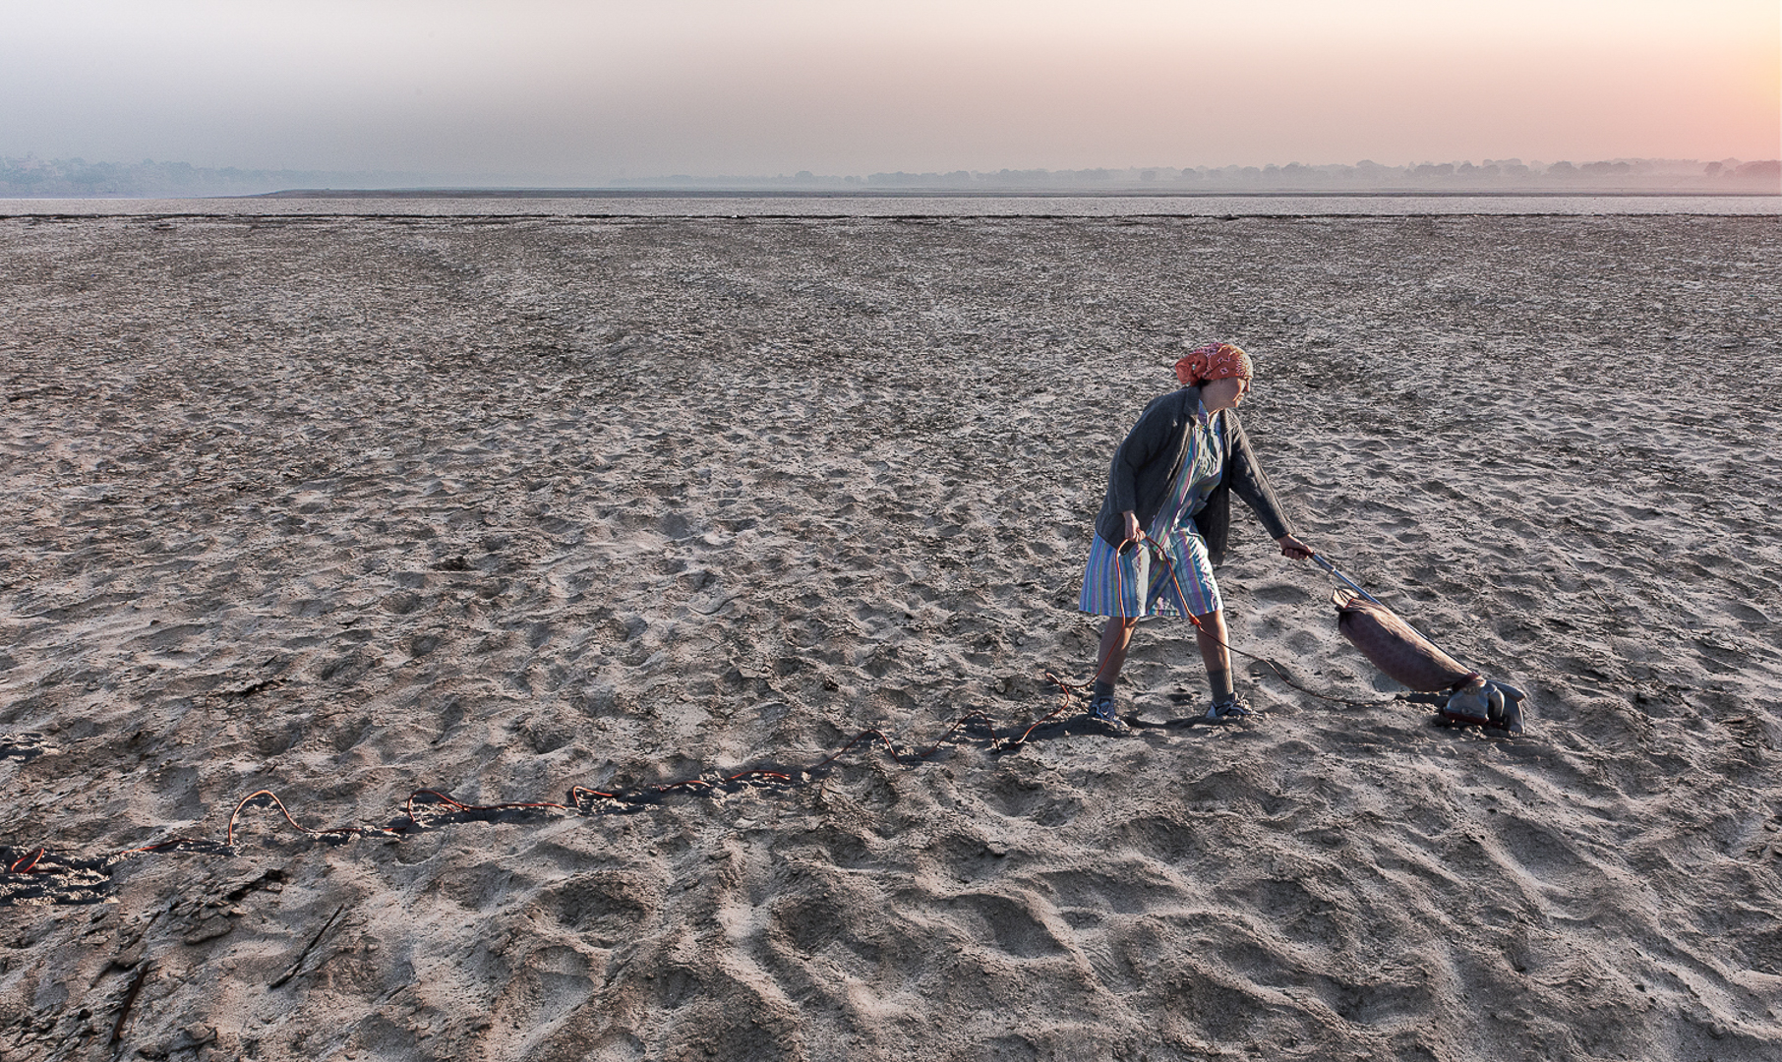
Photograph by Susan (Stevenson) Borowitz
Sandtrap (from Locked In)

Slide 21
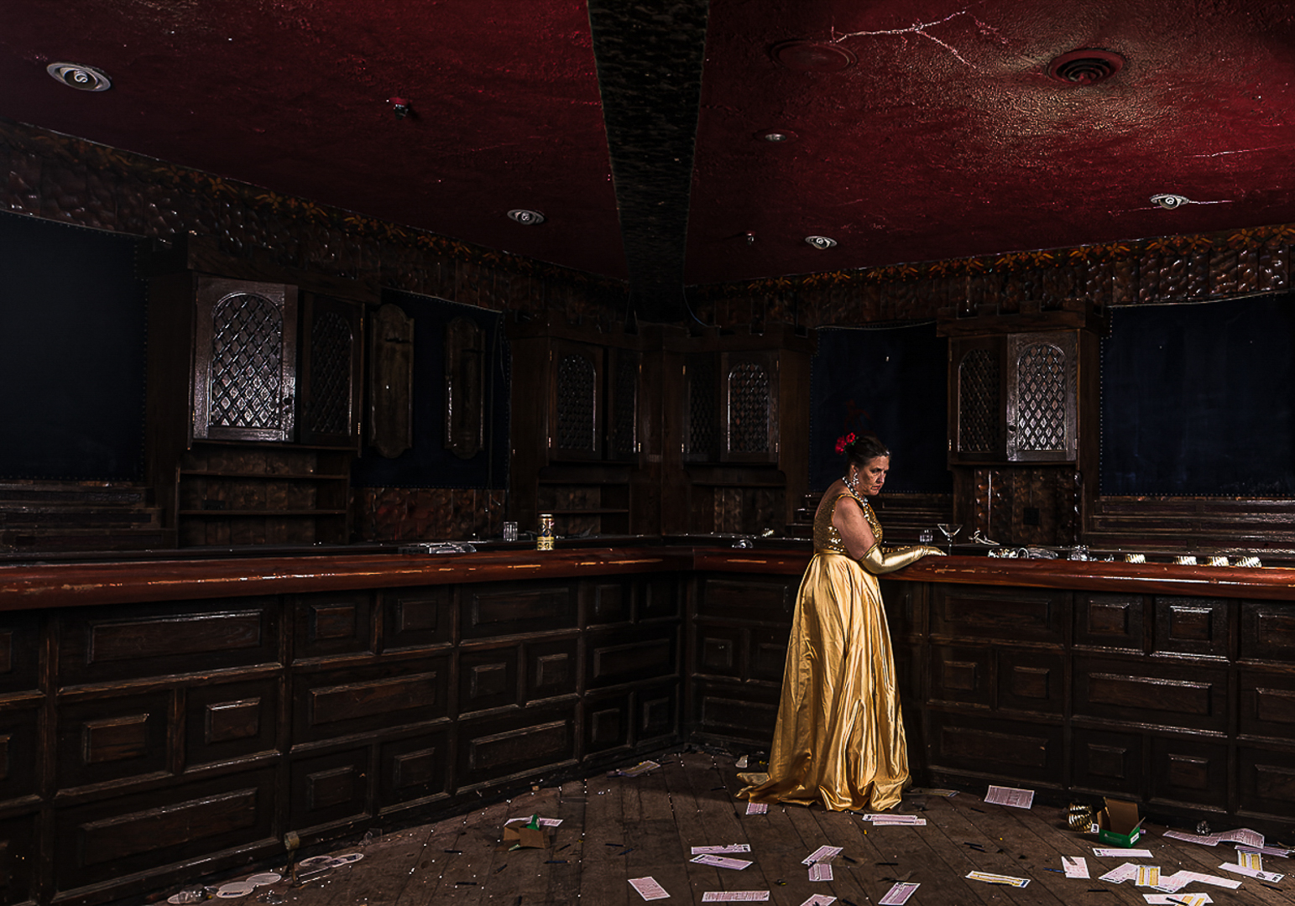
Photograph by Susan (Stevenson) Borowitz
Last Call (from Locked In)

Slide 22
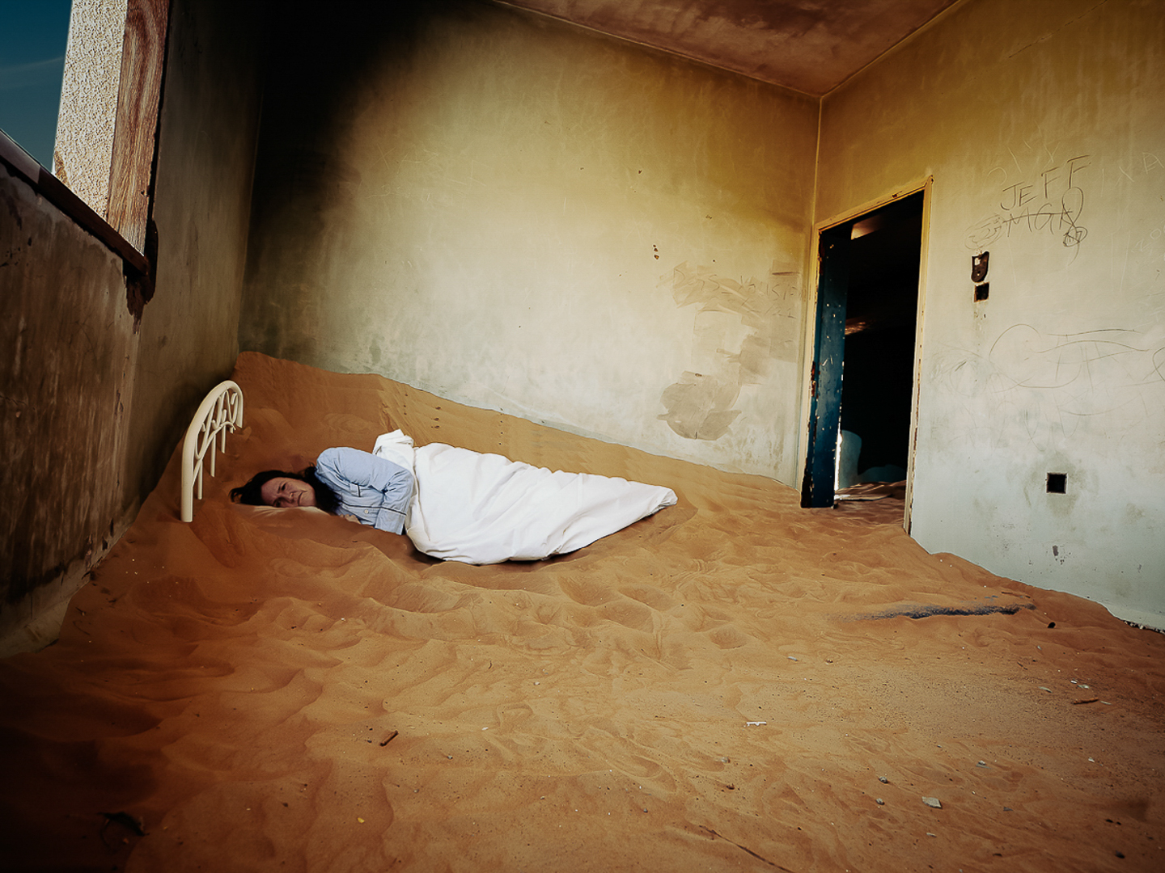
Photograph by Susan (Stevenson) Borowitz
Buried (from Locked In)

Slide 23

Iggy & the Stooges Tribute by Tony Dillof
“Raw Power”, with the band Search and Destroy

Slide 24
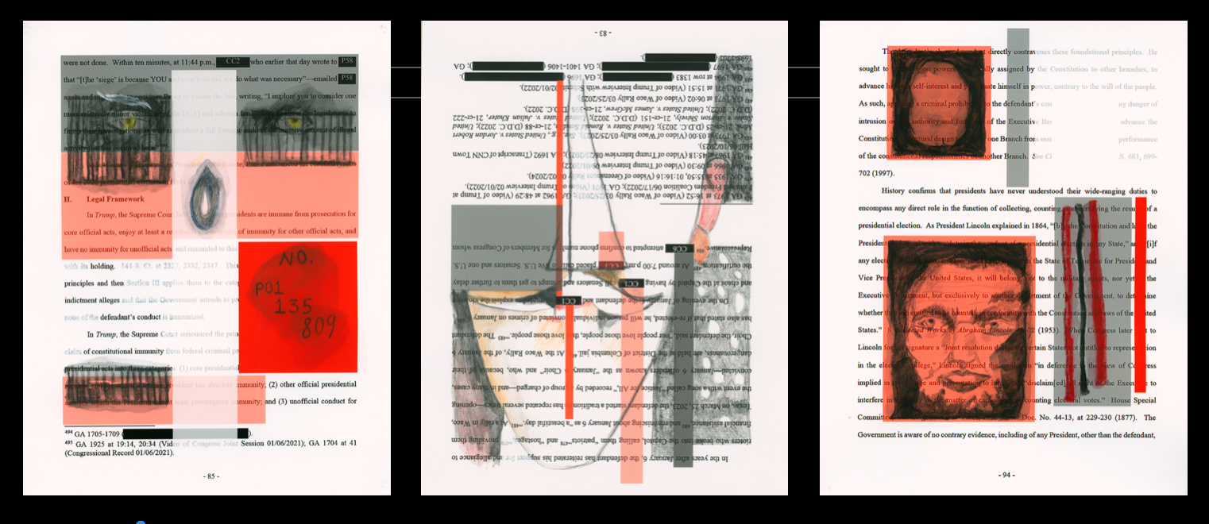
Art by Pia Yona Massie
Portraits triptych (based on Jack Smith’s legal papers)

Slide 25
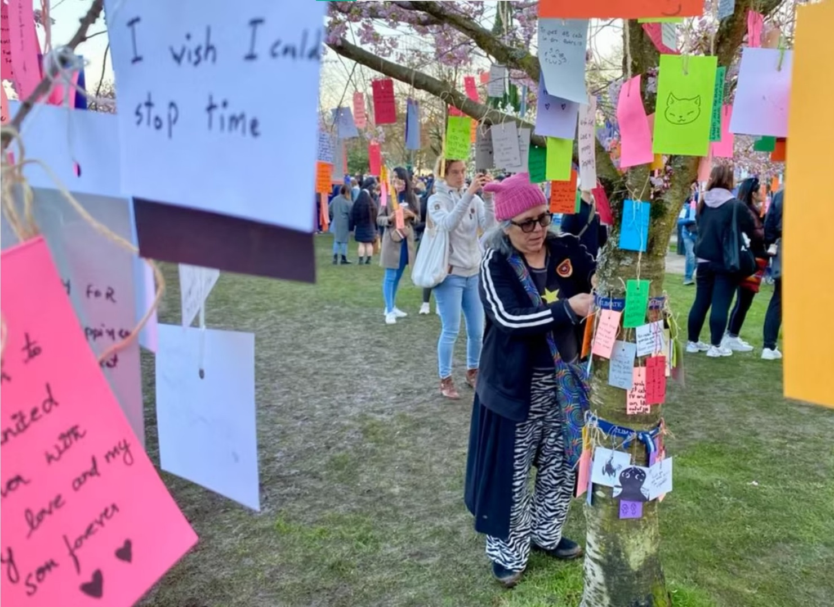
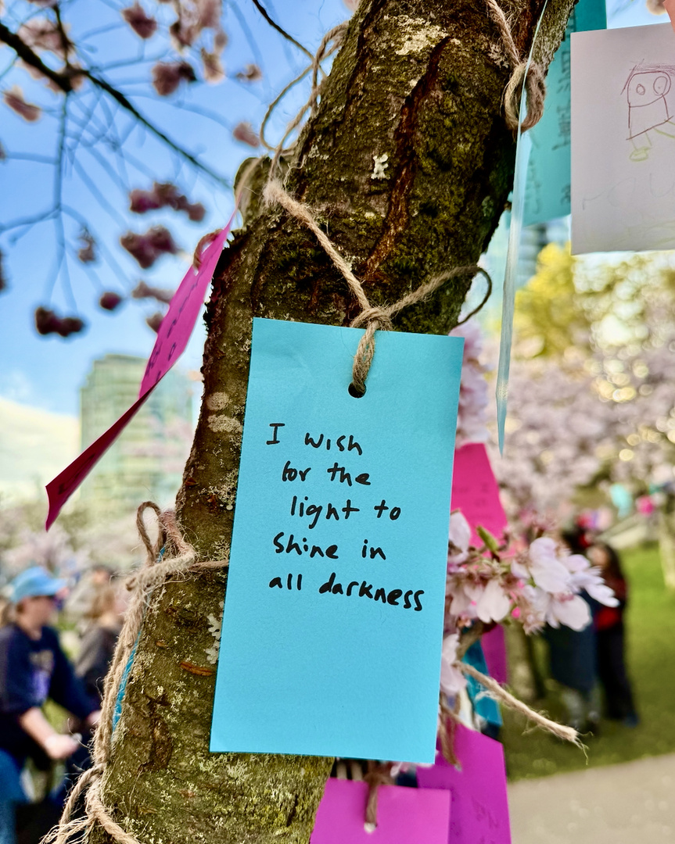
Installation by Pia Yona Massie
Tabanata “Wishing” Tree
Annual ritual & celebration, Vancouver BC, 2024 & 2025

Slide 26
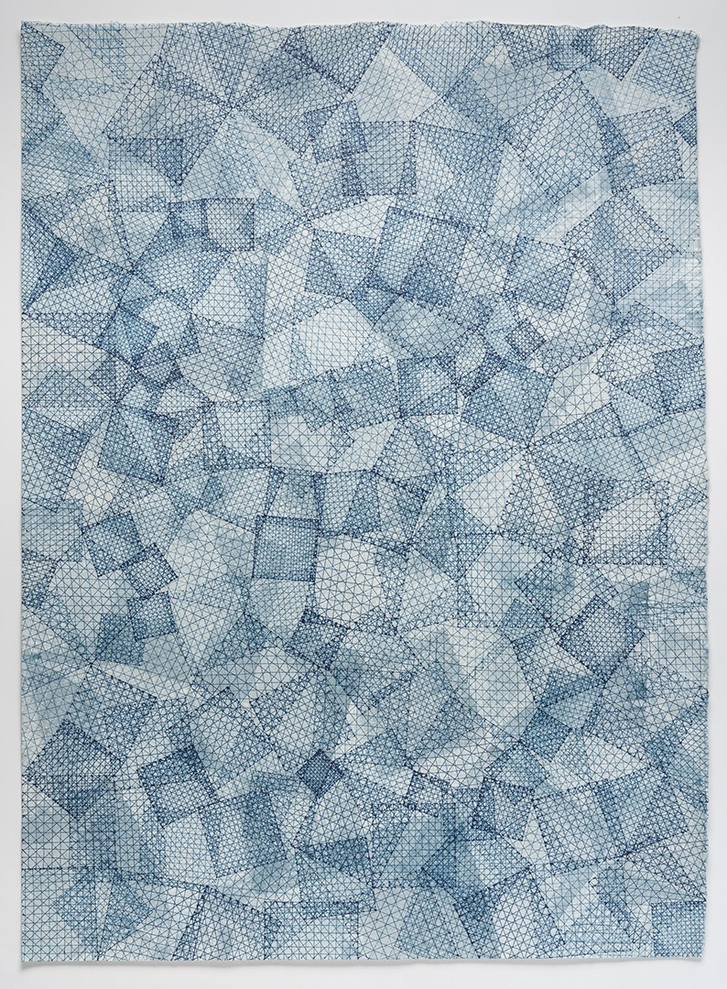
Jeanne Heifetz
Mottainai 89 indigo and ink on paper

Slide 27
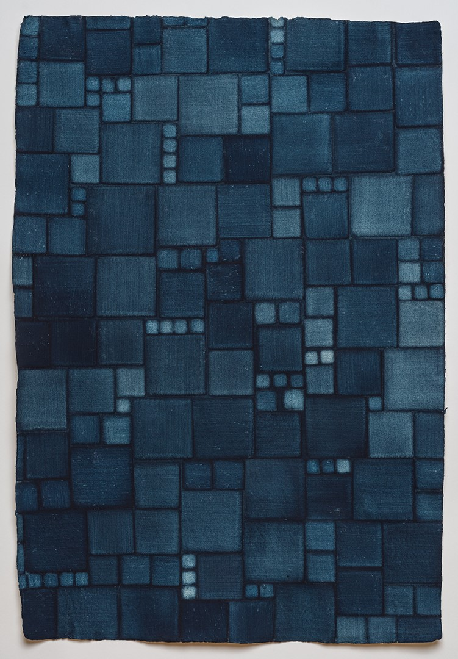
Jeanne Heifetz
Eventide 6 natural indigo on watercolor paper

Slide 28
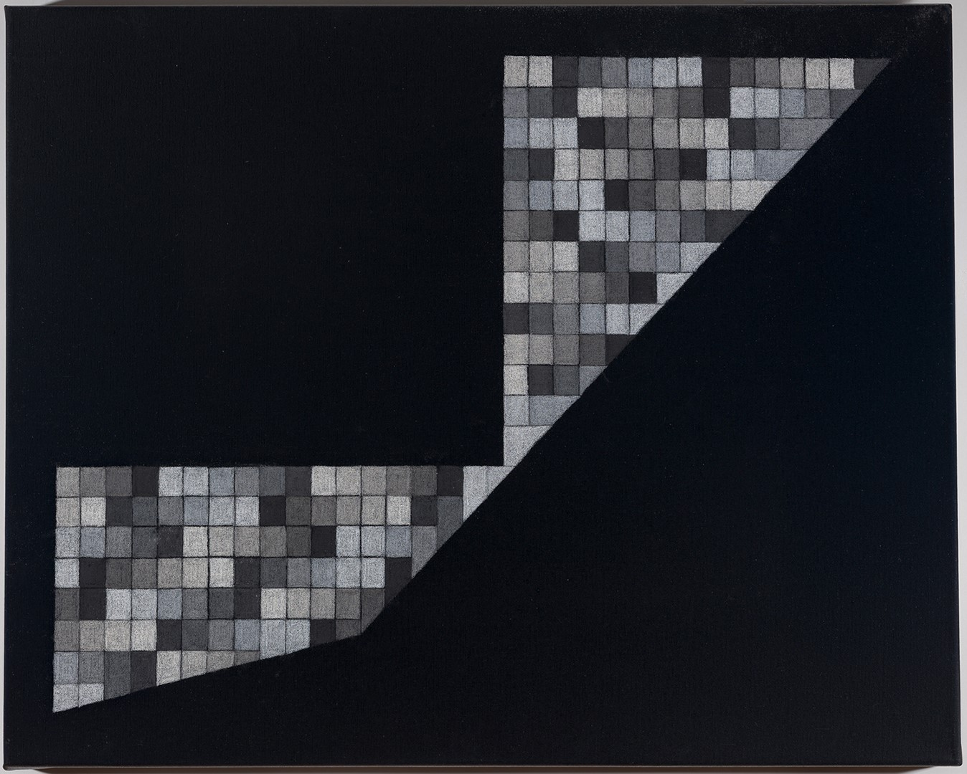
Jeanne Heifetz
A Field of Absence 43 colored pencil on canvas

Slide 29
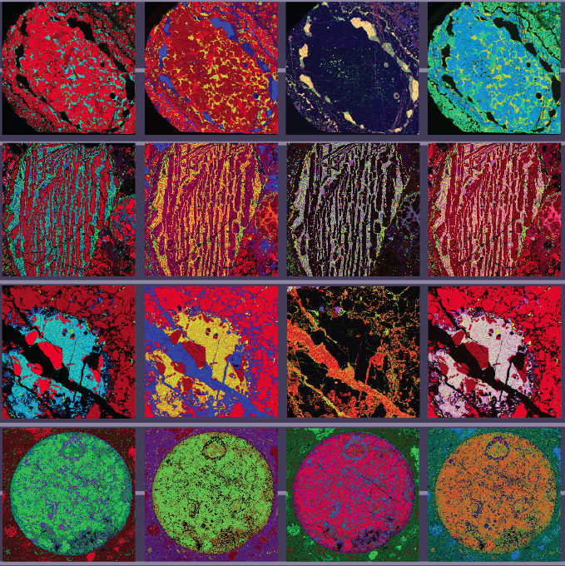
Scientific Art by
Denton Ebel
Computer colored electron microscope maps of meteorite elements
From AMNH exhibit
Picturing Science

Slide 30

Russ Gershon’s Either/Orchestra
Mahmoud Ahmed and the Either/Orchestra: Bemen Sebab Letlash

Slide 31
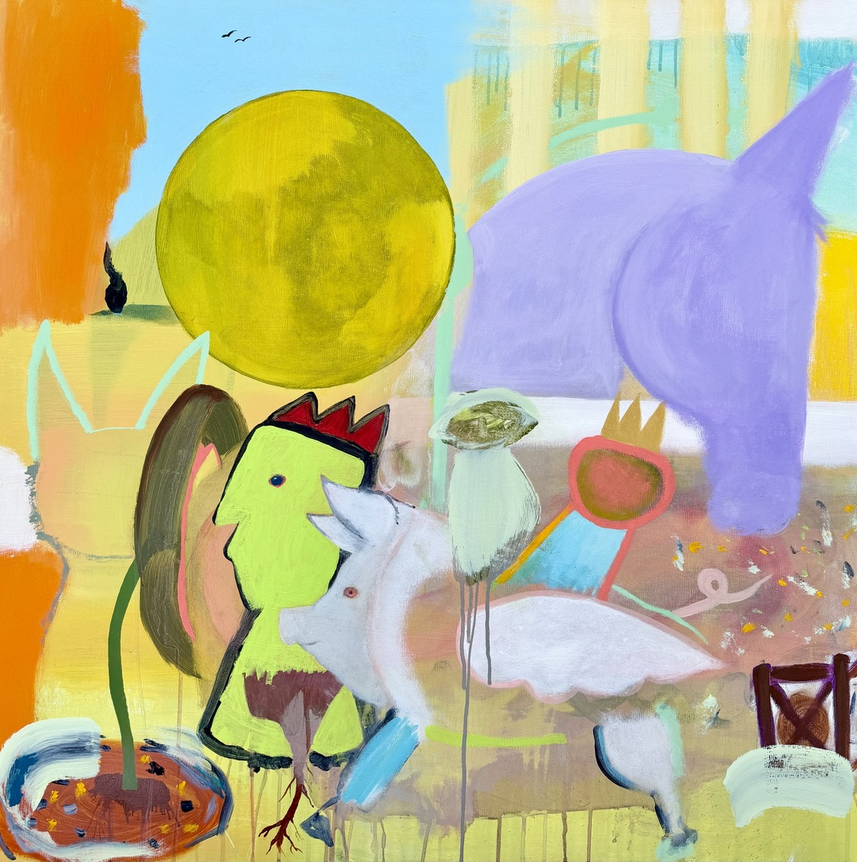
Painting by
Siri Smedvig
Music of Peer Gynt acrylic on canvas

Slide 32
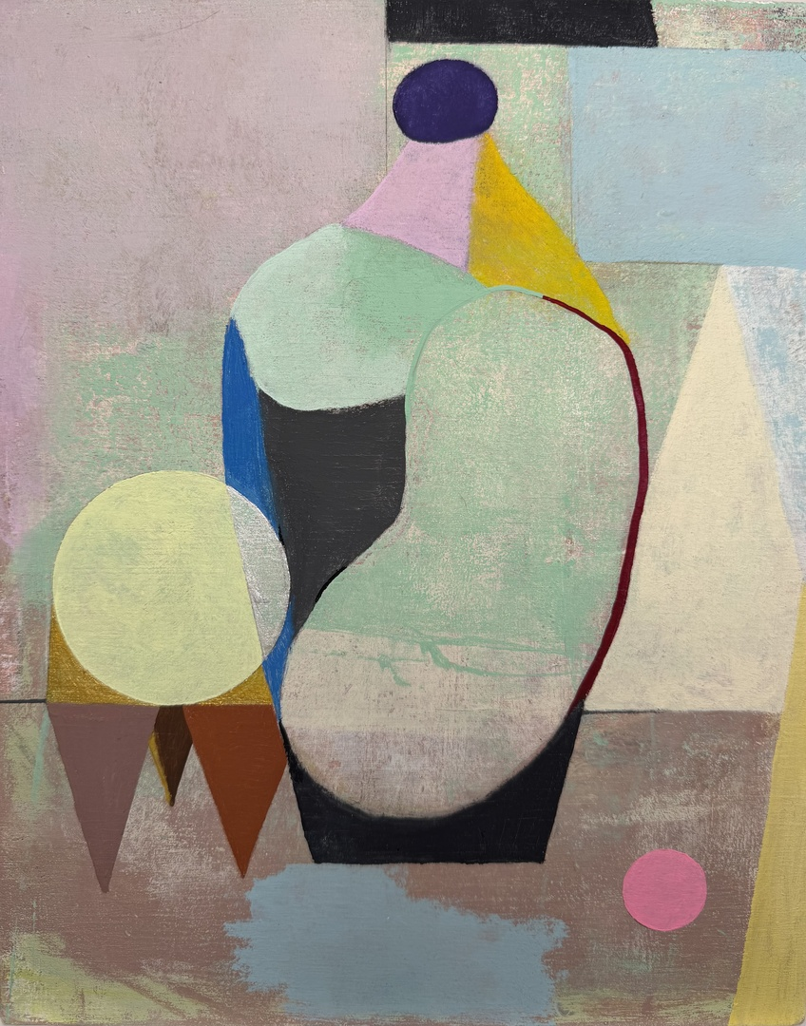
Painting by
Siri Smedvig
Vessel for my Djinn acrylic on wood

Slide 33
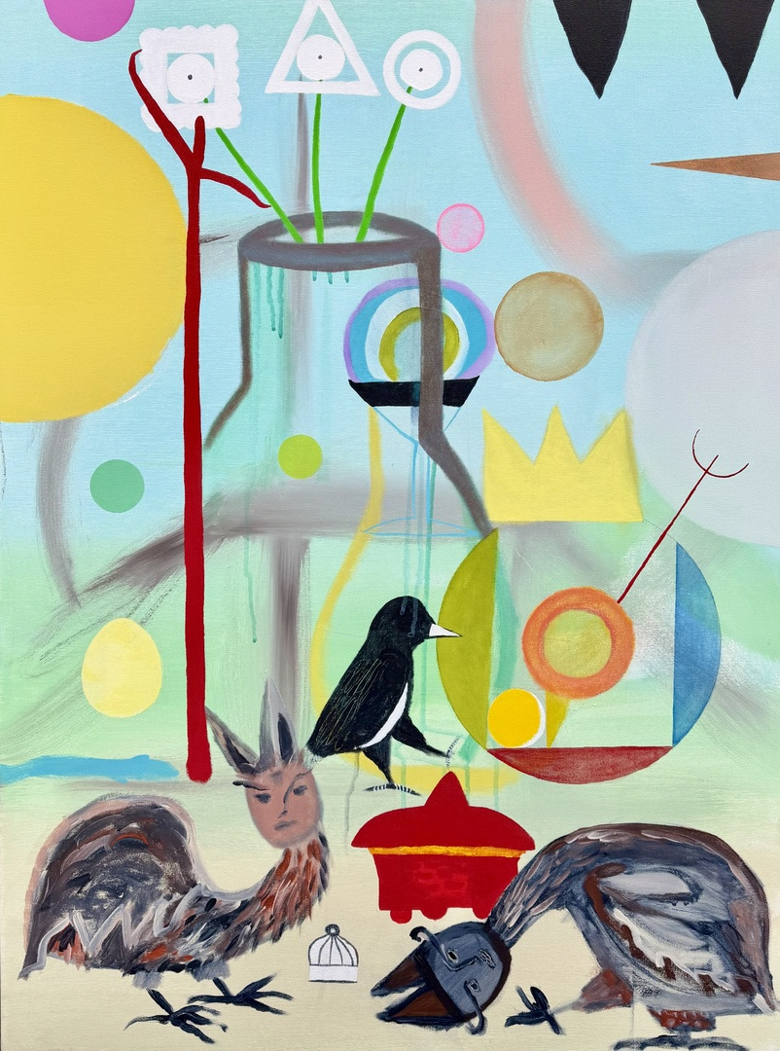
Painting by
Siri Smedvig
Alchemy Circus acrylic on canvas

Slide 34
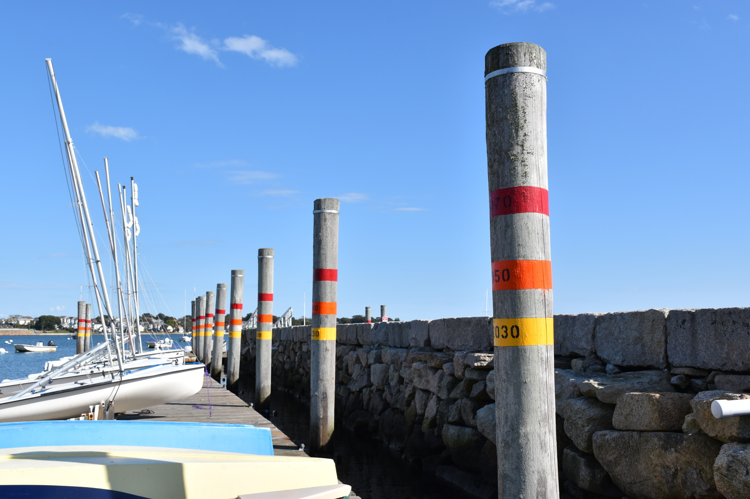
Sculpture by Susan Israel
Future high tide levels, New Bedford Community Boating

Slide 35
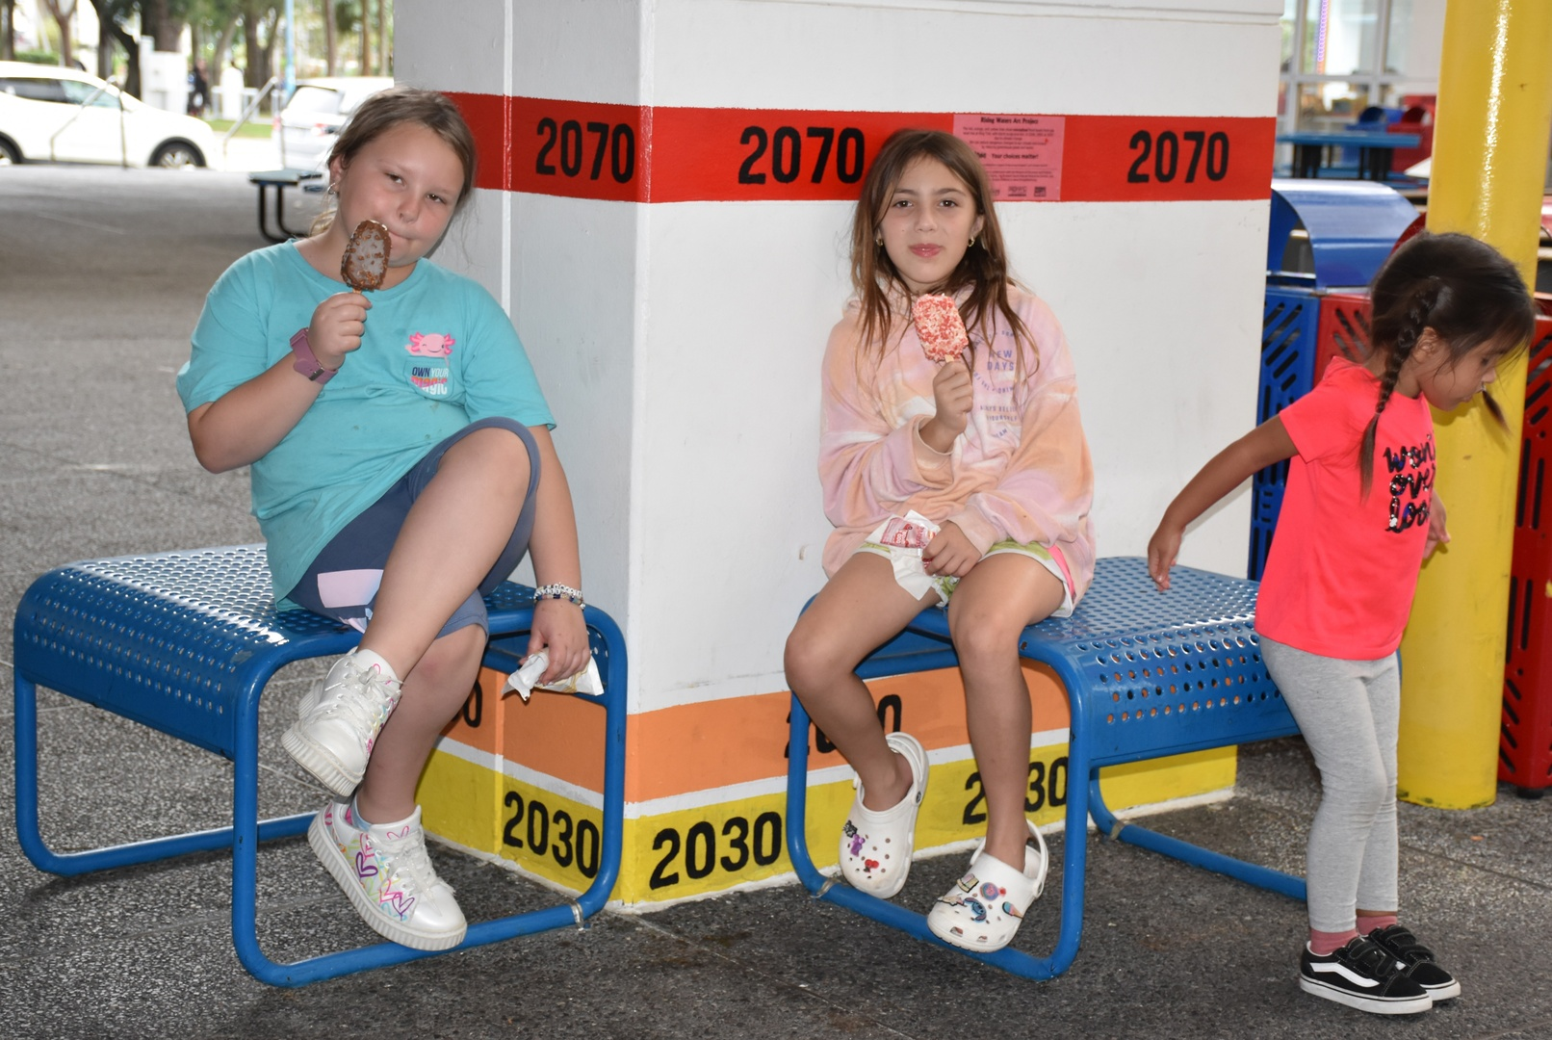
Sculpture by Susan Israel
Storm flood levels, Museum of Discovery & Science, Ft. Lauderdale

Slide 36
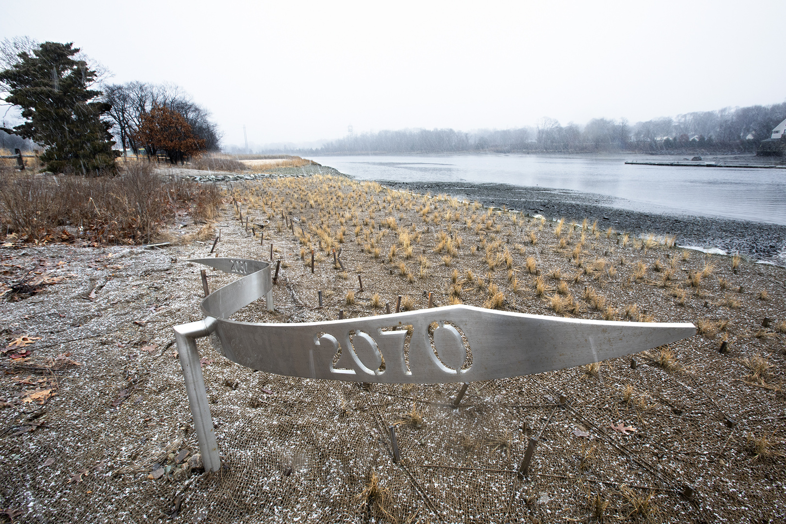
Sculpture by Susan Israel
Sculpture showing future tide levels, for public outreach

Slide 37
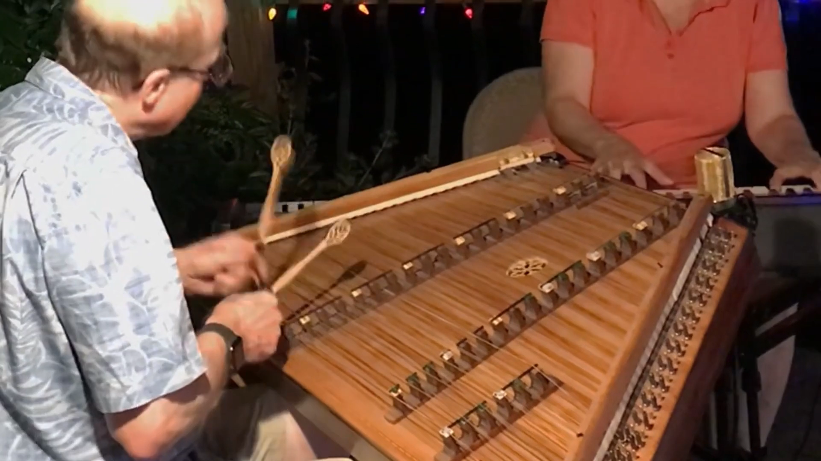
Harry Ferguson & Meg Ziegler Ferguson
Hammered dulcimer & electric piano
MacArthur Road
International Play Music on the Porch Day 2022

Slide 38
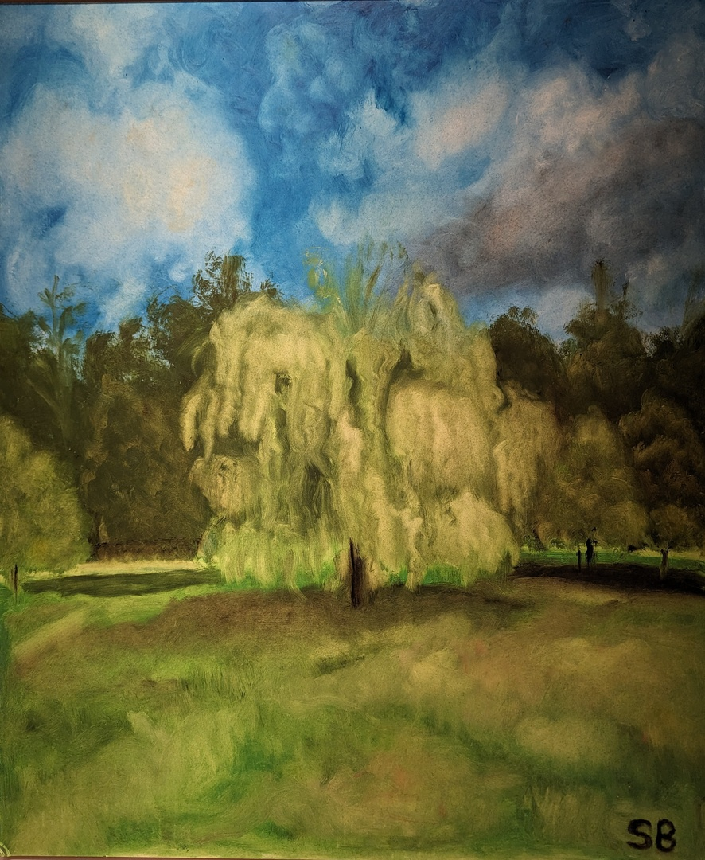
Painting by
Stephanie Breslow
Golden Summer oil on board

Slide 39
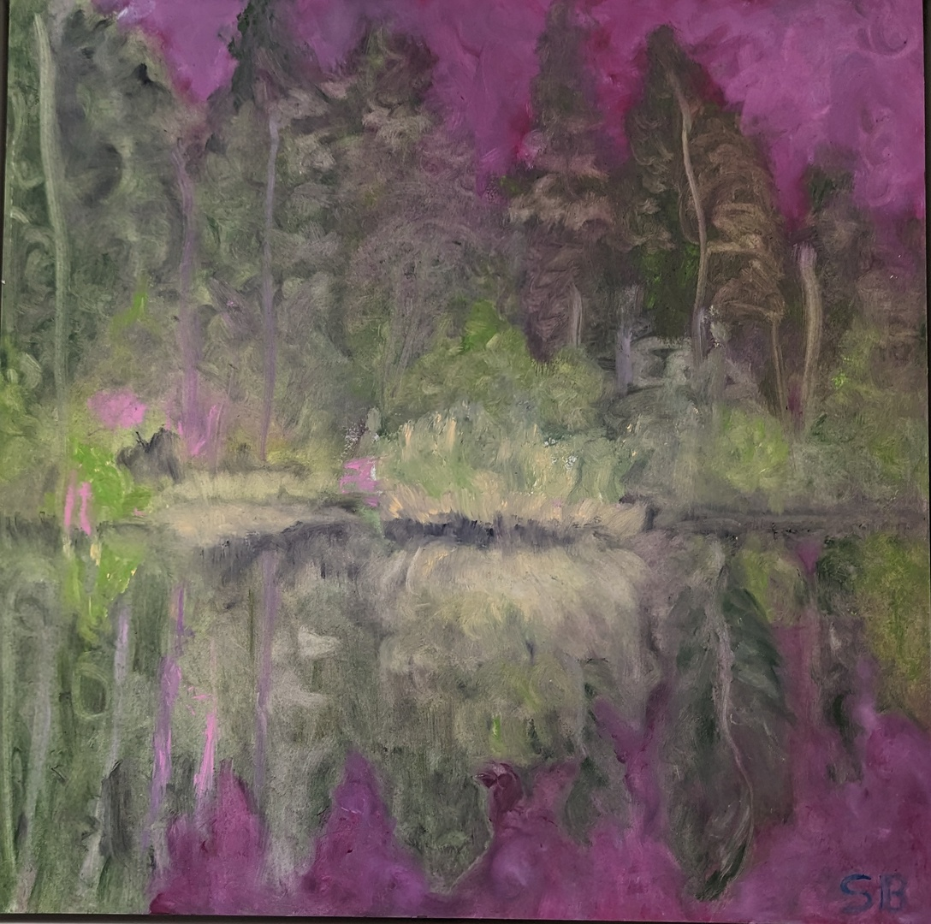
Painting by
Stephanie Breslow
Highland Sunset oil on board

Slide 40
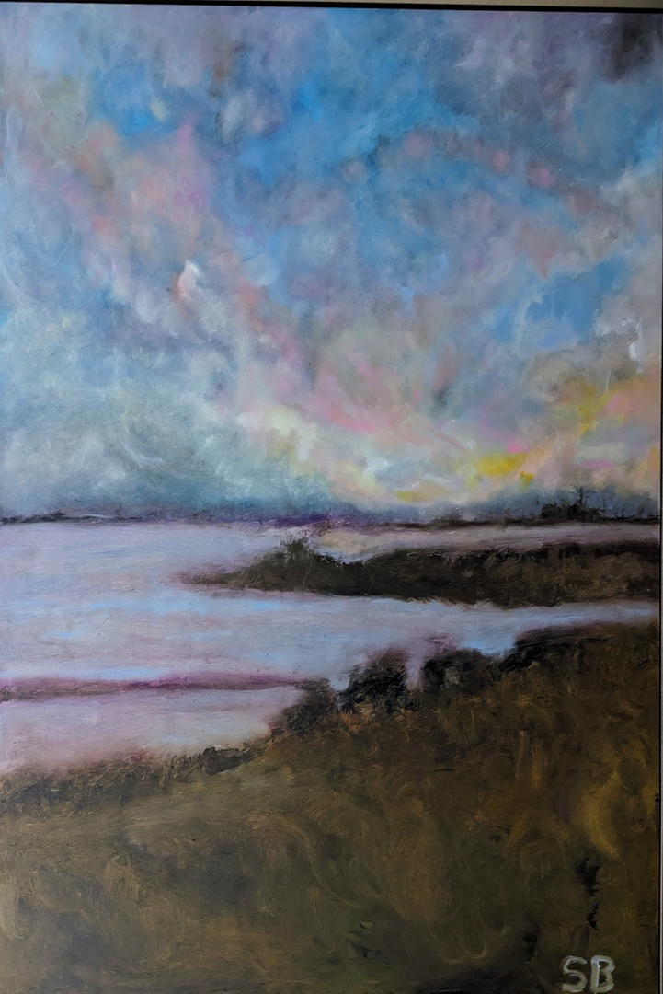
Painting by
Stephanie Breslow
Moonglow oil on board

Slide 41
Glimpses
(Classmate creations only)
HR1981 45th Reunion
Created and Produced by:
Dan Scherlis
and
Kate Elliott Scherlis

