Slide 1
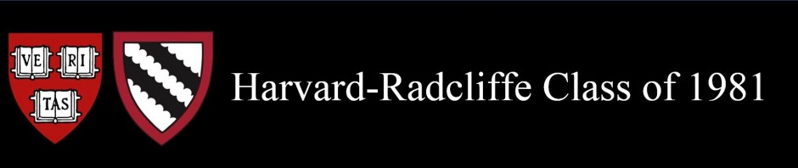
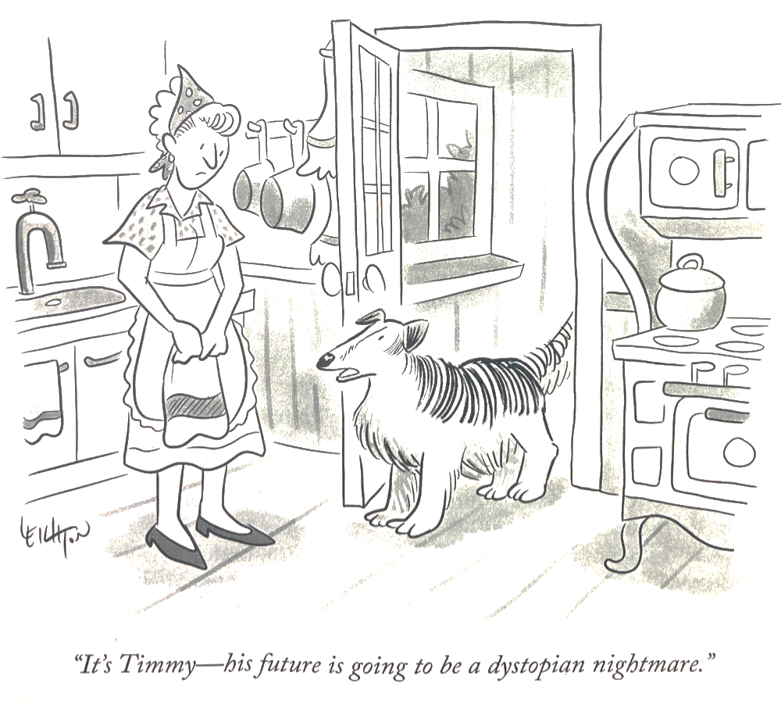

Slide 2

In Your Own Words
45th Reunion Survey Highlights

Slide 3

Presenters: your survey committee
Hilary Gonzalez Morrison, Chair
Archie Todd Morrison III
Russell Baris
James Whiting
Barbara Koh
Andrew Sellon

Slide 4
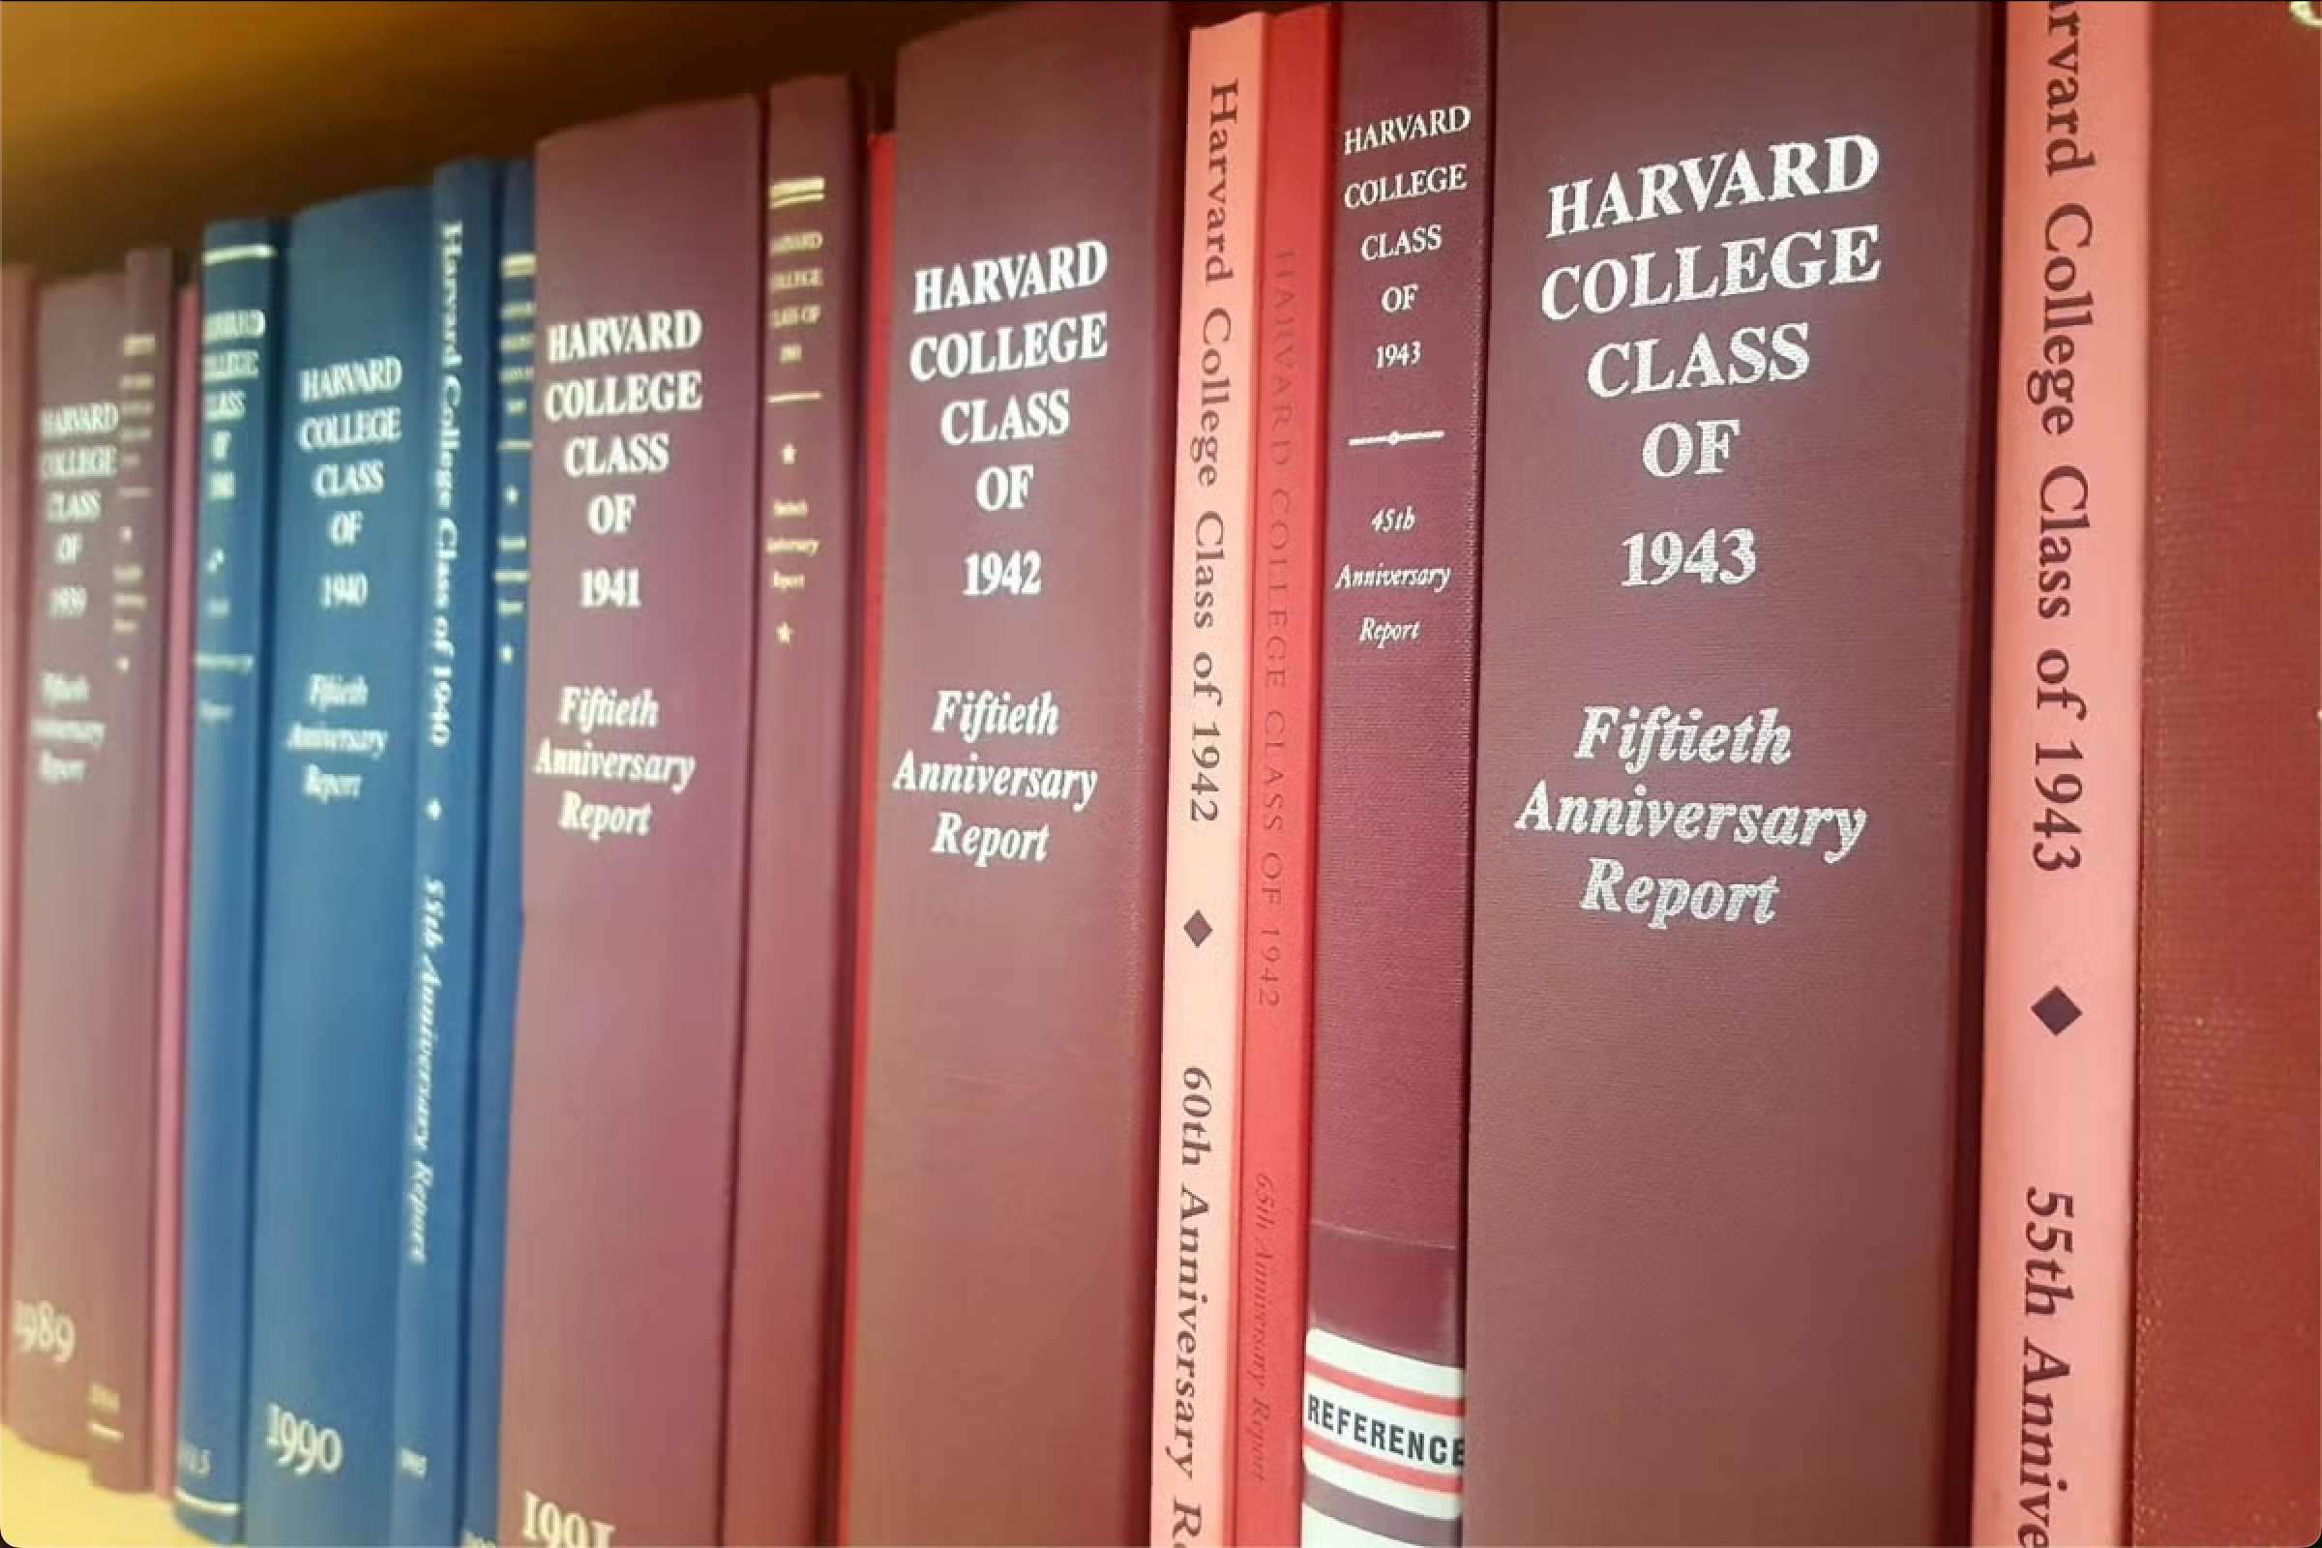
About our survey
Our emphasis was on comparing Then vs. Now
Anonymity allowed free (and extremely frank) expression of classmates’ views! 😳
Some quotes have been edited in the interest of space/civility
Total responses: 342 or about 20%!
And the house that delivered the highest number of responses was… [GUESS!]

Slide 5
What was your house affiliation?
Top Responder: DUNSTER HOUSE!
33%
Notes:
I calculated the percent response by dividing the number of respondents from each house by the number of classmates assigned to it. Do you find the result surprising?

Slide 6
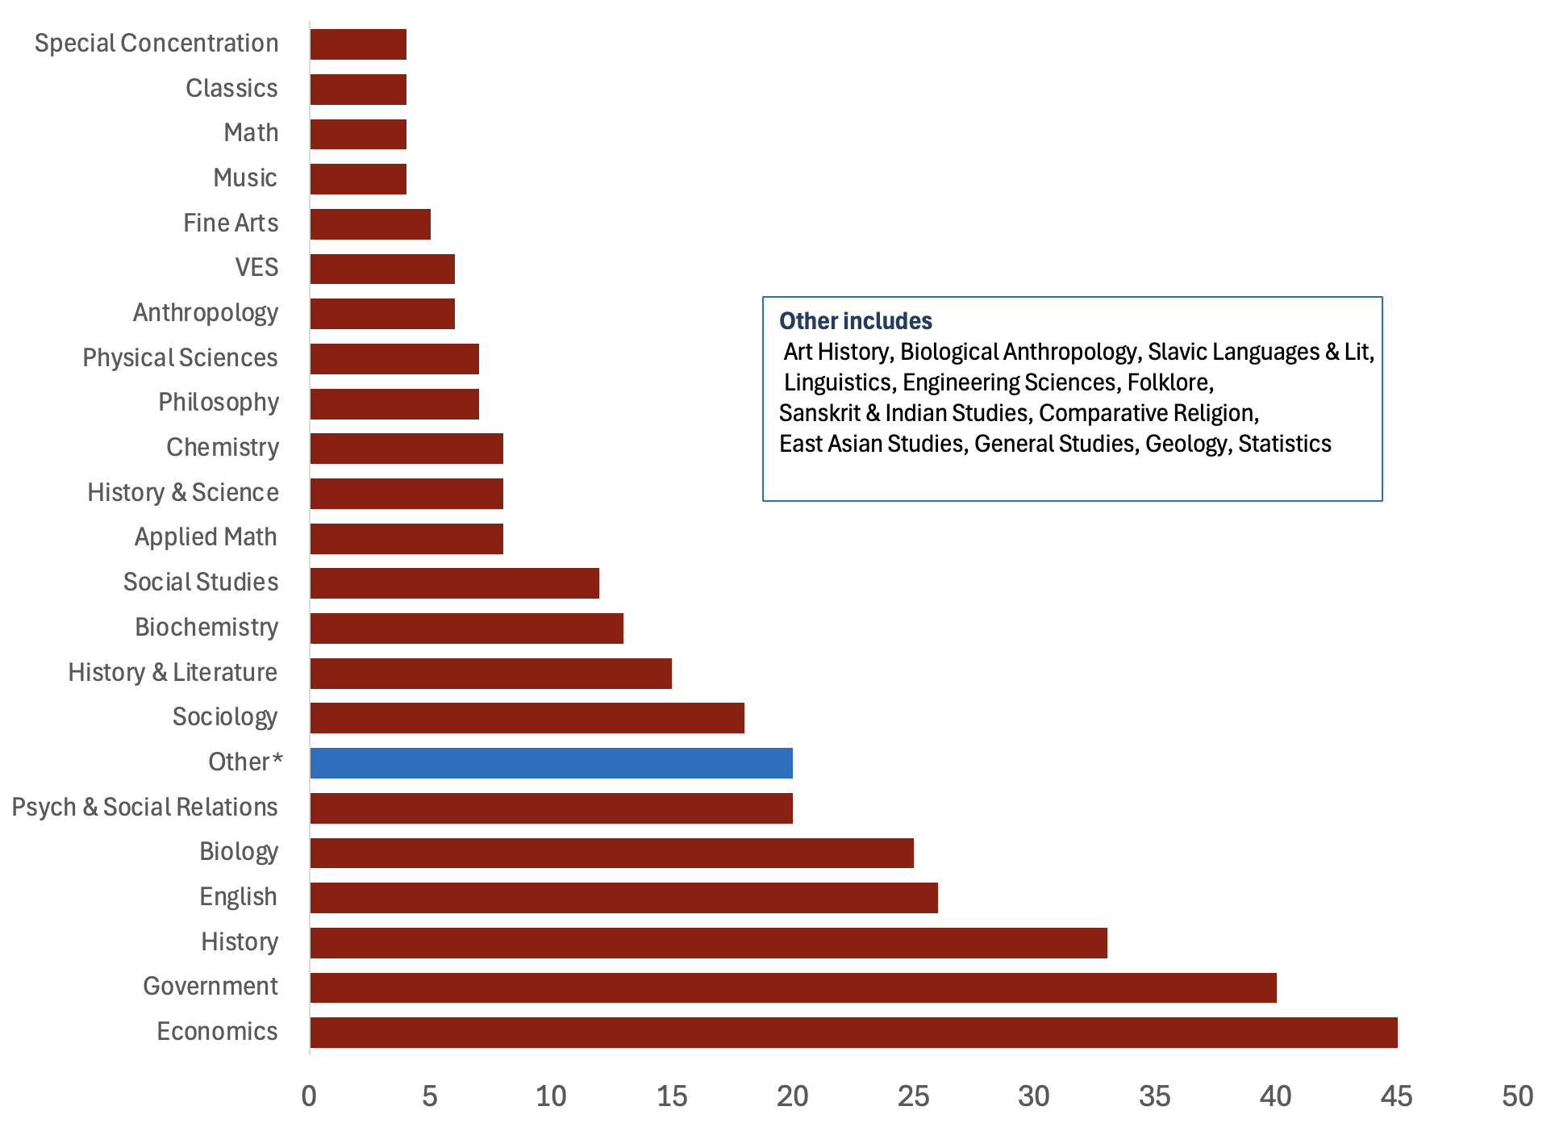
2. What was your concentration?
Notes:
Ec and Gov types dominated the response pool. I never knew some of the 'other' concentrations were possible.

Slide 7
How much bearing did your concentration have on your career?
Bearing | Number of Respondents | Percentage of Respondents
A Lot | 138 | 42%
Mattered | 38 | 11%
Some | 66 | 20%
A Little | 36 | 11%
None / Nearly None | 54 | 16%
Total Respondents: | 332

Slide 8
How much bearing did your concentration have on your career?
Bearing | Nat Sci | % | Soc Sci | % | Hum | %
A Lot | 40 | 56% | 67 | 33% | 31 | 53%
Mattered | 6 | 8% | 28 | 14% | 4 | 7%
Some | 10 | 14% | 46 | 23% | 10 | 17%
A Little | 6 | 8% | 25 | 12% | 5 | 8%
None / Nearly None | 9 | 13% | 36 | 18% | 9 | 15%
Total Respondents: | 71 | 21% | 202 | 61% | 59 | 18%
At Least Some |  | 78% |  | 70% |  | 77%

Slide 9
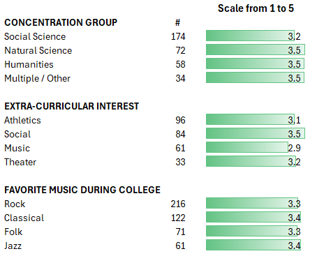
How much bearing did your concentration have on your career?
Breakdown by college interests

Slide 10
Didn’t bear directly but taught me to think/write/speak clearly/logically/coherently, and that was very important.
[Sociology]: As I studied deviant group behavior, it helped me understand the unique dynamics inherent in my industry.
Very little. I should have majored in History and Literature.

Slide 11
What else was important to you?
Activity | Respondents | %
Sports | 167 | 25%
Varsity/JV/Freshman | 62 | 9%
Club | 8 | 1%
Intramural | 37 | 6%
Recreation/General | 60 | 9%
Friends | 118 | 18%
Generally | 102 | 16%
Conversations | 7 | 1%
Significant Other | 7 | 1%
Music | 70 | 11%
Generally | 33 | 5%
Playing/Singing | 37 | 6%
Activity | Respondents | %
Groups/Organizations | 67 | 10%
Restaurants/Nightlife | 39 | 6%
Theater (on/back stage) | 37 | 6%
Newspapers/Journals | 28 | 4%
House Life | 25 | 4%
Volunteering/PBH | 24 | 4%
Working | 21 | 3%
Political Activity | 21 | 3%
Expanding Horizons | 16 | 2%
Reading/Writing/Research | 12 | 2%
WHRB | 10 | 2%
Partying/Drinking/Drugs | 5 | 1%

Slide 12
I enjoyed picking some corner of the Widener stacks at random and reading books from that section.
Lampoon / Girlfriend (not in that order)
Misspent Youth (my real concentration)

Slide 13
Spontaneous serious, philosophical, political, or completely nonsensical conversations and arguments that stretched late into the night.
Eating/hanging/playing Missile Command with friends … dropping a Canadian flag over a separatist premier …
Friendships that have lasted for life.

Slide 14
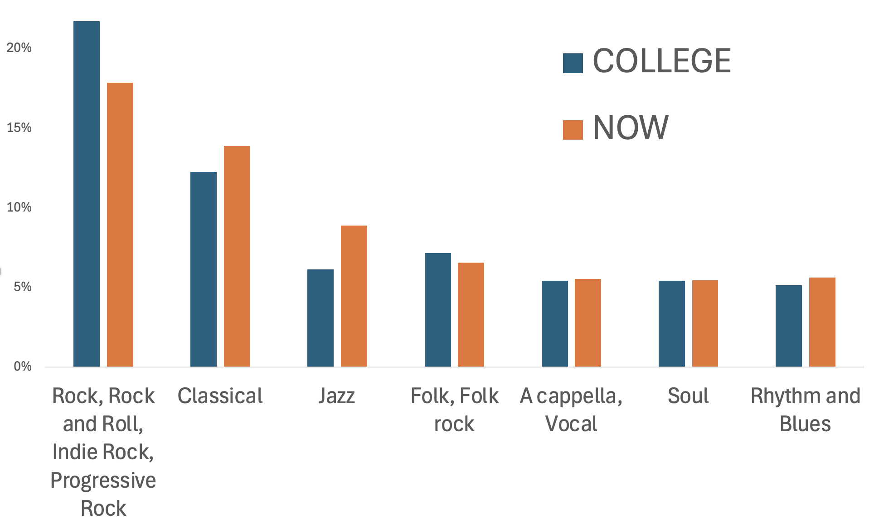
What were your favorite types of music in college? What about now?
Notes:
Rock, classical, and jazz music were the most common answers. I got a lot of flak for the way I lumped genres together. I blame Wikipedia. Not enough people listed particular pieces of music to put together a mix tape or whatever it's called now.

Slide 15
What is your favorite house memory?
Top Answers:
Amazing dining hall conversations
Just hanging with roomies and new friends
Social hours at the Masters’ Houses
The parties! (Dance/Toga/Beach)
The Adams House clothing optional pool
Notes:
Far and away the top response here was some form of celebrating the stimulating conversations we had in dining hall! Other than that, hanging out or attending the house master teas came up a lot, as did various forms of partying, of course—including more than one creative beach solution, at least one involving a large amount of actual sand deposited in a common room. You know who you are. And while some of us were never invited (ahem), there were a surprising number of votes for the Adams House clothing optional pool.
Here are some of your “favorite house memory” quotes….

Slide 16
“YMCA” being performed by our house proctors
First real spring day: everyone sat out in the courtyard
1AM false fire drills that revealed some interesting couples

Slide 17
Seeing the pride on my family’s faces as I received my diploma
Listening to Yo Yo Ma practicing next door
I would give anything for another lazy afternoon sitting in the dining hall just talking with my friends.

Slide 18
What do you miss most about Harvard?
Top Answers:
The friends I made there
The intellectual stimulation of always being surrounded by smart, interesting people
The libraries and museums
Late night conversations on deep topics
My youth
Notes:
There were two top answers here: the friends we all made, and the sheer stimulation of being around so many smart people eager to talk and debate. There were also a number of appreciative votes for Harvard’s amazing libraries and museums, as well as those late night deep talks. And a few people answered quite bluntly: My Youth!
Here’s three key quotes from you all:

Slide 19
The sense that anything was possible
The sense that everyone belonged
Civilized debate about any subject

Slide 20
What’s a moment from your Harvard days that still makes you laugh, cringe, or smile??
The Blizzard of ‘78!
Parties/Alcohol/Antics
Freshman discoveries
Lasting friendships
Serious moments
Only @Harvard
Cringe? Too many to list….
Notes:
This question took you deeper down memory lane.
Blizzard of ‘78: The one & only Blizzard! The blizzard that bonded the class. That caused the first & only Harvard-wide closure due to snow….Snowball fights in the Yard. Skiing down Mass Ave. Walking & cross-country skiing, sometimes alone, on the frozen Charles —quote, “Glorious and dumb.”
Antics: Scorpion Bowls. Sneaking to the roof of the Science Ctr. Streaking, & checking a book out of Lamont while naked. Exchanging pranks. Thank god there were no cell phones then.
Freshman Year: First day, when I realized everyone was as overwhelmed as I was, which was weirdly comforting.
Realizing how much I didn't know.
Trying to find someone friendly to sit with in the Freshman Union.
Dancing with a lampshade on my head & getting my roommates to join in.
Lasting Friendships: Friendships brought lots of warmth: Singing with teammates on buses. Roommates & friends helping when we’re injured. Several people met their future spouses at Harvard.
Serious Moments included South Africa anti-apartheid and divestment protests. Misogynist jokes. Sexual assault.
[ONLY @ Hvd] Moments unique to Hvd included accessorizing John Hvd’s statue.
And one classmate wrote, “For my Expository Writing class, I went to Houghton Library thinking they’d have a reference book on a John Keats poem. The librarian brought out some of Keats' original manuscripts.”
[Cringe] Now, what you’ve all been waiting for: CRINGE. Throughout all 4 yrs! Especially in romantic & social situations– Trying to impress our crushes. Being self absorbed, even thoughtlessly cruel, vis-a-vis roommates and dates.

Slide 21
Locking myself out of the WHRB studio where I left an album playing on air, only to have it reach the end so listeners heard the needle repeatedly bouncing for 10 minutes. When I got back in, I announced it was ”a test of the emergency broadcast system.”
“Sometimes we laugh when we really want to cry”—The observation from my adviser a few days before my thesis was due, when I could only meet her questions and suggestions with sleep-deprived fits of giggling.

Slide 22
I cringe when I remember omitting numbers in the sequence of pages in English papers to make it look like they were longer than they actually were. 1, 2, 3, 5, 6, 8, 9, etc.
The undefeated Harvard Rugby Football club—and the fact that in our pregame huddle, we said a poem.
When a gas cylinder corroded, the lab filled to waist-level with NOx, a brown corrosive gas. Stepping into the emergency shower caused my pants to dissolve, leaving me in just seams.

Slide 23
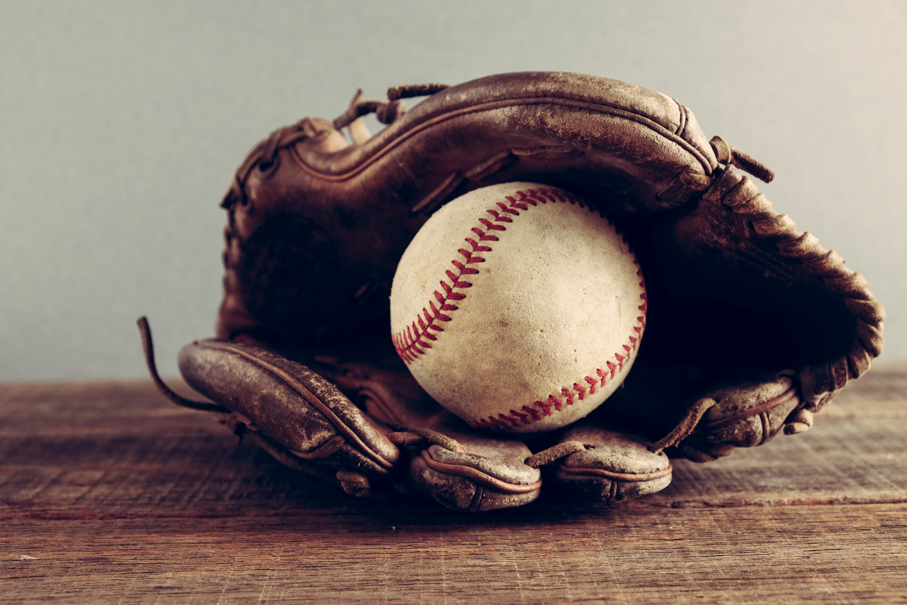
A classmate invited 3 of us to a Red Sox game. Carl Yastrzemski was on the verge of 3,000 hits. Outside Fenway, our friend said he’d lost his ticket and sent us in ahead while he retraced his steps. Only recently, I’ve realized he’d really had only 3 tickets & was determined that his friends witness Yaz’s milestone. It was a gift of kindness & honor we’ll never forget.
Notes:
This quote is about a moment we can all appreciate, regardless of how we feel about the Red Sox or baseball.

Slide 24
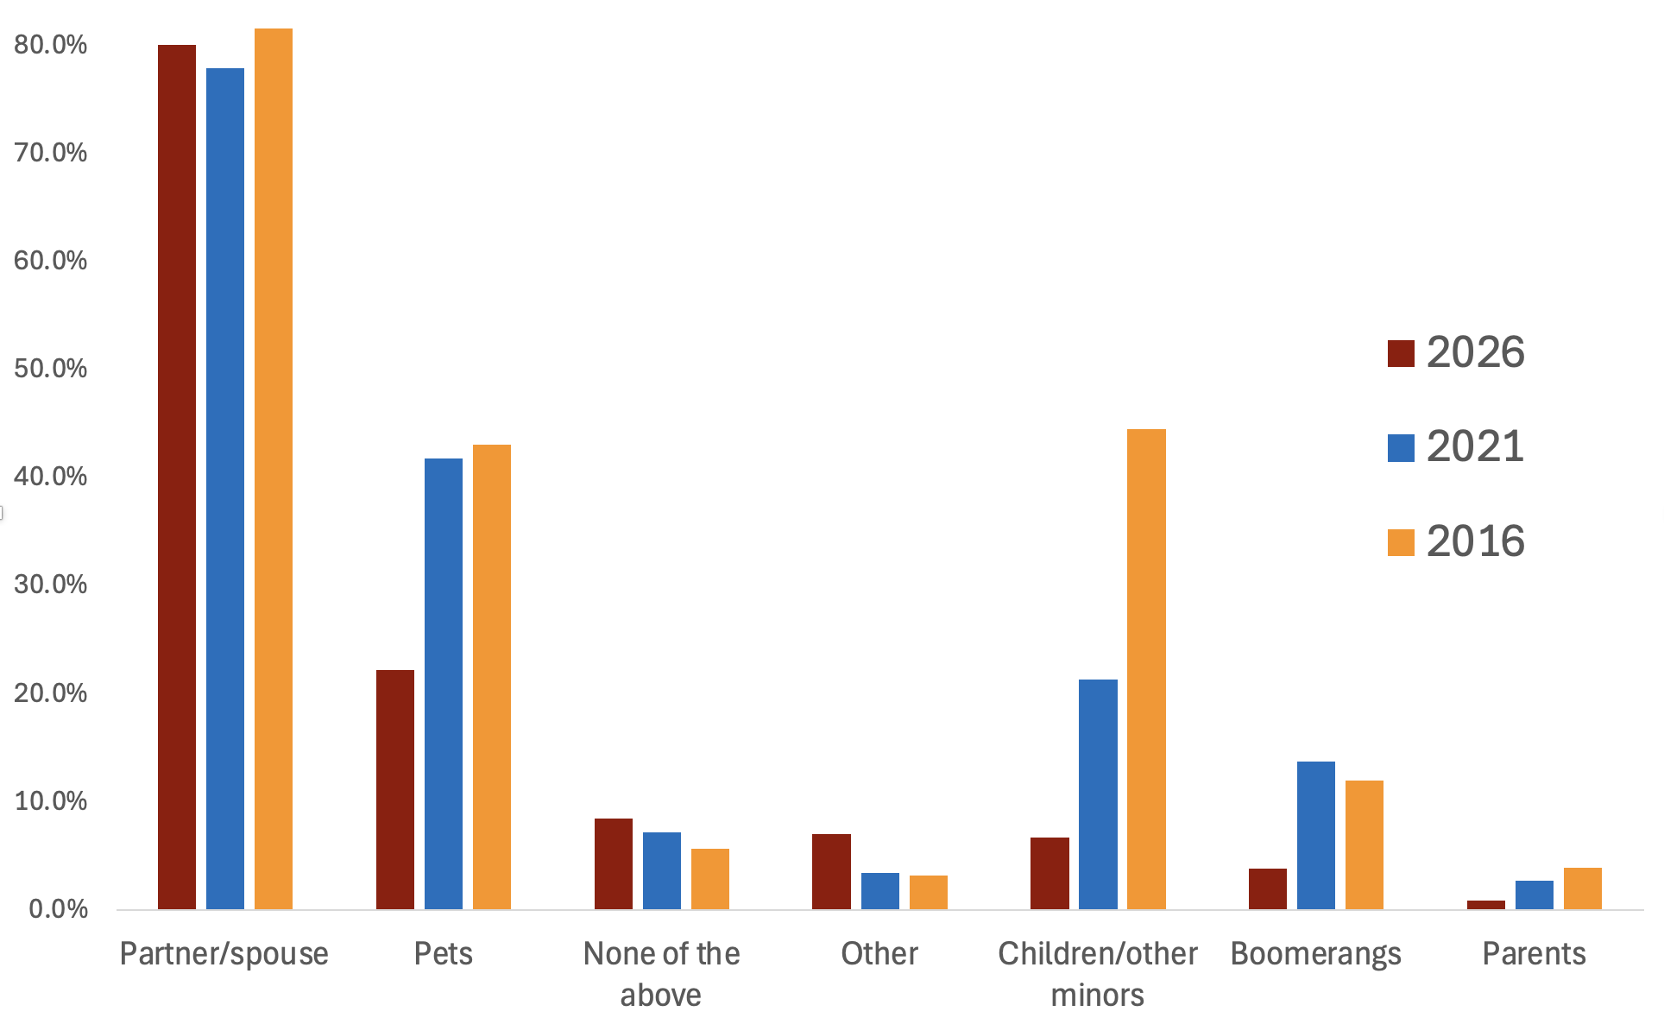
With whom do you live?
Notes:
Not much change in our households. 80% of us still like living with a partner, but the children seem to have moved out.

Slide 25
What brings you the most contentment in your personal life these days?
Spending time with and being happy about: | 319
Significant Other | 59
Children/Grandchildren | 90
Family | 79
Friends (and other humans) | 77
Pets (and Livestock) | 14
Recreation | 261
Physical (sports, hiking, biking, birding) | 72
Intellectual (puzzles, reading/writing, learning/research | 55
Cultural (museums, music) | 44
Travel | 29
Cooking/Dining | 18
Gardening | 12
Hobbies/Projects/Domiciles | 14
Getting out into Nature | 17

Slide 26
What brings you the most contentment in your personal life these days?
Category | 127
Work (meaningful, well done) | 35
Teaching/Mentoring/Helping Others | 28
Volunteering/(Positive) Politics/Religious Practice | 29
Kicking Back and Just Watching/Enjoying/Being | 35

Slide 27
Seeing what good people my children have become as adults.
Reading, music, fighting fascists.
Being with the one I love.

Slide 28
Laughter. 😂
Love. ❤️
A good night’s sleep. 😴

Slide 29
Who are your closest or most important group of friends?
When/Where/How Met
HR81 (Roommates, shared activities) | 165 | 33%
Shared Activity/Organization/Neighbors (since HR81) | 82 | 16%
High School (or earlier, grade and middle school) | 59 | 12%
Family (especially spouse)/Through Family | 50 | 10%
Work/Service/Colleagues/Students | 51 | 10%
Grad School | 26 | 5%
Through Children | 19 | 4%
Everywhere and Anywhere | 43 | 2%
HR81 (Reunions and Otherwise) | 4 | 1%
Pets | 1 | <1%
 | 500 | 81%

Slide 30
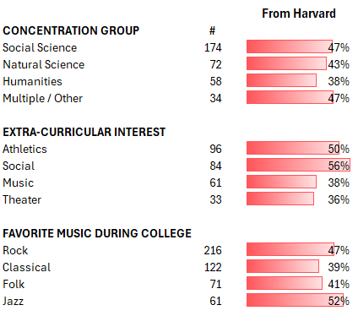
Who are your closest or most important group of friends?

Slide 31
A divergent group of people, largely questionable, it would seem, for their judgement to hold me dear.
I have four women who are around the same age. We call ourselves "The Board" and have regular "Meetings".
I don't have a coherent group of friends. Instead, I seem to have accumulated a tiny handful of friends from each phase of my life. It has been a pleasure, over the years, to bring some of these disparate friends together.

Slide 32
Friends I met while raising our children.
HR1981 people I didn't know in college.
My closest friends in college are still my closest friends, almost 50 years later.

Slide 33
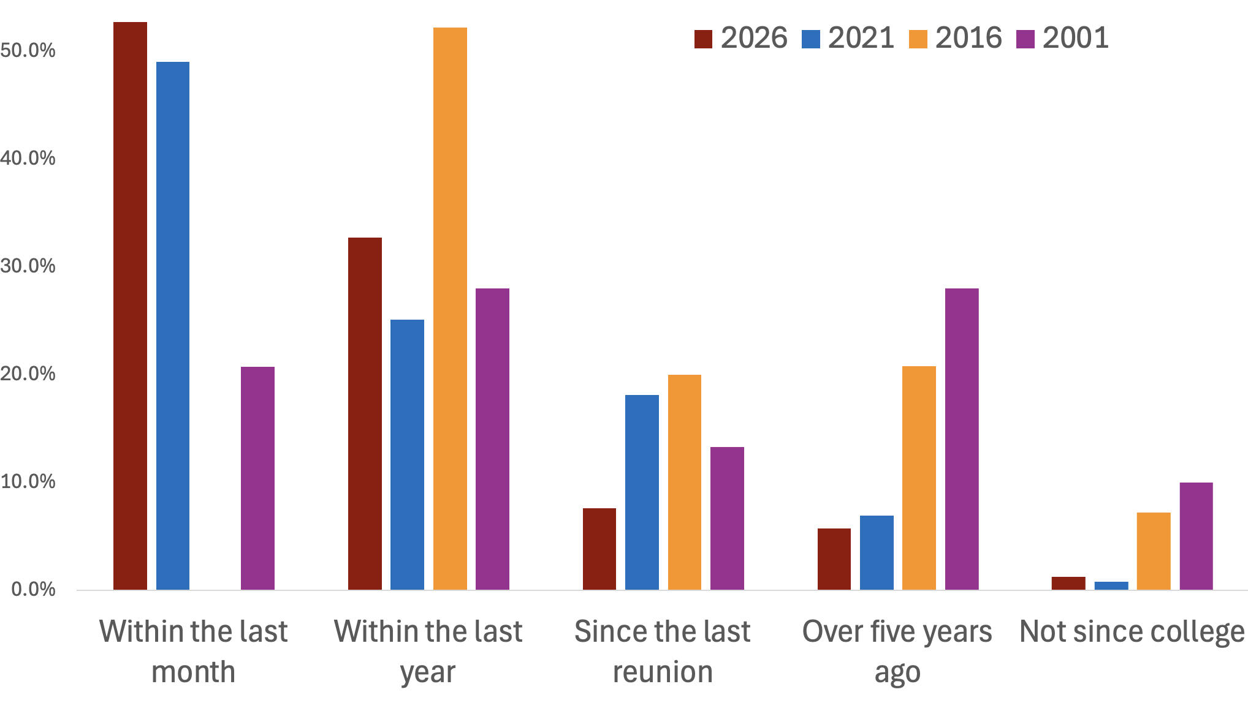
When did you last see a college friend or roommate?
Notes:
It's pretty impressive that about three-quarters of us saw a college friend or roommate within the past year. We heard from a lot of class couples, but they didn't affect the numbers (much).

Slide 34
How have your relationships with extended family changed?
Major Trends:
Relationships have remained the same or grown even stronger over time
Losing parents leads to greater sibling closeness OR
Losing parents leads to distance and conflict
Addition of in-laws, grandchildren, family by choice are generally seen as positives
Video conferencing is great!
Notes:
So, we maintain college connections, but we have mixed feelings about our extended families, especially after our parents' generation is gone.

Slide 35
Impacted by politics and right-wing radicalization. Still close with two brothers but estranged from another.
They have become closer. I really enjoy my family.
I care for my Mom. She used to care for me.

Slide 36
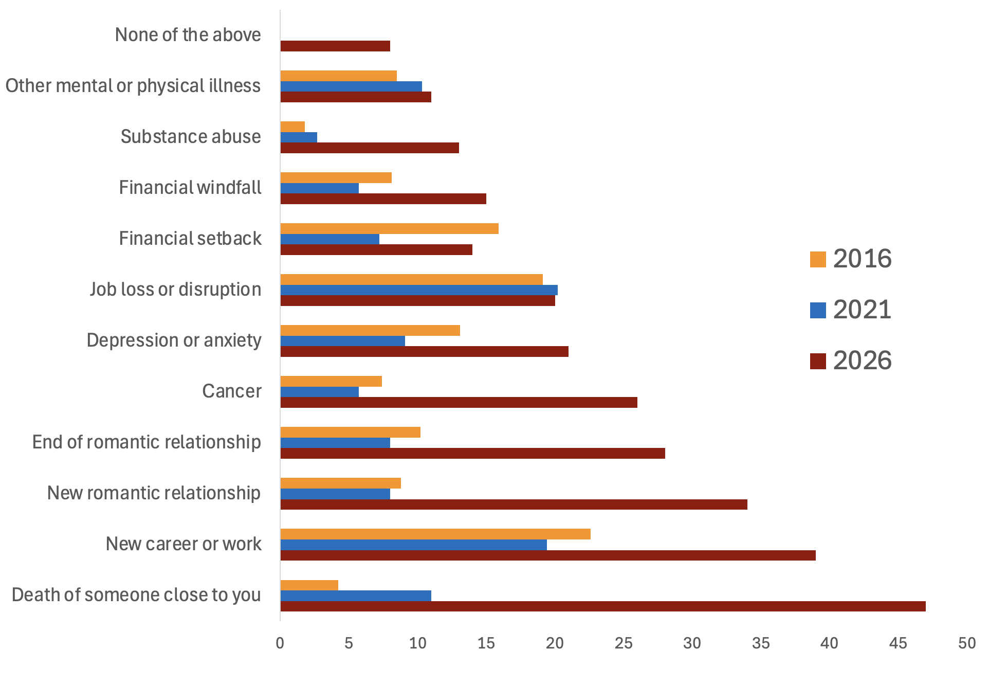
Which of these events have had a major impact on your life since graduation?*
*Prior to the 2026 survey, the question was phrased as “...in the past five years”

Slide 37
What values are most important to you?
Integrity, honesty, truth
Kindness, compassion, empathy
Justice, fairness, civic values
Connection
Wide open door
Ethical/religious guidelines
Notes:
Integrity, honesty, truth are the clear leaders of the pack. Ethical behavior especially when no one’s watching.
Kindness & empathy come in second, named by 33% of us.
Justice & fairness are important values, as is doing the work– so there were answers like “political involvement“ and “repair our democracy.”
Connection Many of us listed family, friends, community, commitments to and caring for others–which I tied together as connectedness–i.e., “Acknowledging we are one.“
Closely related is a widely open-door – Curiosity, inclusion, wonder, nuance. Have an open mind and open heart. Listen even if you don’t agree. And don’t forget love and tolerance for yourself.
Also cited were the Ten Commandments, Tikkun Olam– tee-KOON oh-LAHM (repairing the world), and The Golden Rule. One classmate noted, “Christian values (even though I am a lapsed Catholic).”
Other responses: Humility, Humor, Beauty. “To stand up and be counted.” “Love, harmony, & the company of a beloved dog.”

Slide 38
I am far easier than I used to be on minor imperfections, but tougher on basic ethical values of honesty and work.
The secular values of The Lord of the Rings: Fidelity to principles/just causes, and loyalty to friends.
Balance: not too high, not too low. The world seems so hopeless now I can't bear to list external values.

Slide 39
What has been your most life-changing event since graduating?
Top Answers:
Parenthood
Marriage
Divorce
Battling serious illness
Losing loved ones
Becoming a caregiver
Notes:
What do you folks think was the number one answer to this one…?
Far and away the top answer: Parenthood. Followed closely by Marriage and then Divorce. The circle of life. Or love. But at this point in our lives, many folks also mentioned a number of other major life events, including battling cancer or other serious illnesses, or caring for someone who was, losing loved ones, and becoming a caregiver for an aging relative.
Here are some other quotes about most life-changing event….

Slide 40
Reaching an age where reflection has become as important as ambition.
Years of therapy!
Coming into sudden wealth.
Notes:
This might be an opportune moment to mention that I am now an orphan. And as you saw from the previous slide, parenthood is incredibly rewarding. I’ll just put that out there.

Slide 41
Are you still in the career field you imagined for yourself while at Harvard?
Notes:
Hi, I’m Jim Whiting from the class. I was in Eliot and I have 6 questions to review from the survey. 2 of the questions were more backwards looking, 3 are more about our current situation and negotiating the life changes from working to retirement, or maybe “less working” and the last is more of a sumup. So let’s get started. By far the most straightforward of my questions was this one: ‘are you still in your imagined career field. It was a multiple choice question and you can see the answers here……go thru the figure

Slide 42
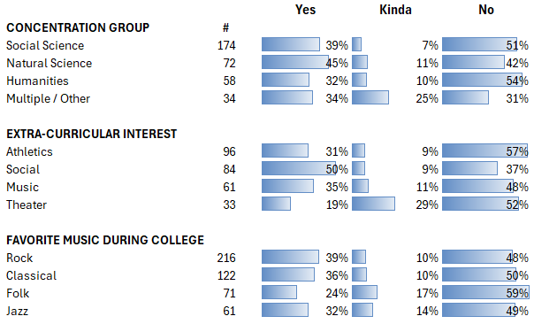
Are you still in the career field you imagined for yourself while at Harvard?
Breakdown by college interests

Slide 43
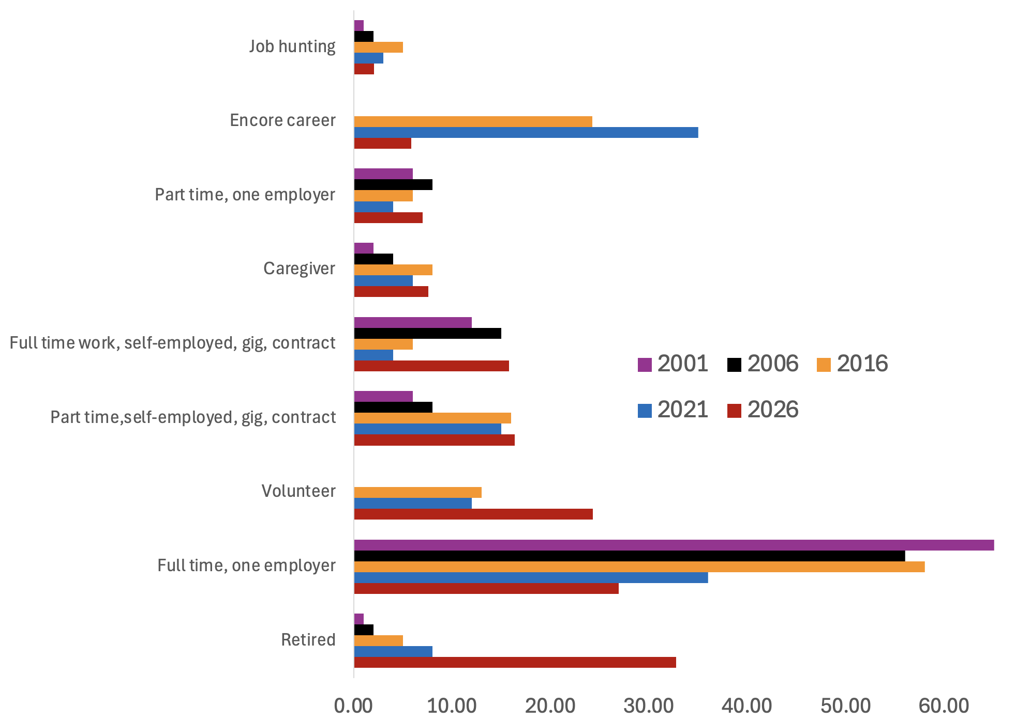
How do you spend your day?
Notes:
Many more of us are retired and volunteering, but a fair number are still working.

Slide 44
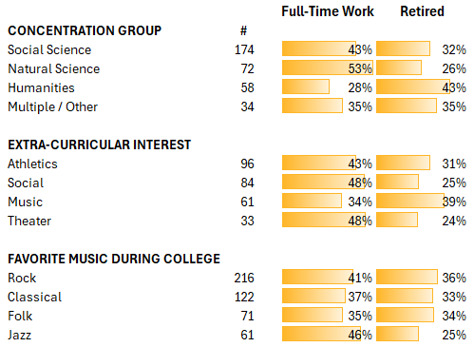
How do you spend your day?

Slide 45
Hell if I know. My day comprises managing email, reading news, tidying, inventorizing, walking to grocery-shop, puttering...
Coach, Bible teacher, friend
Making music and art

Slide 46
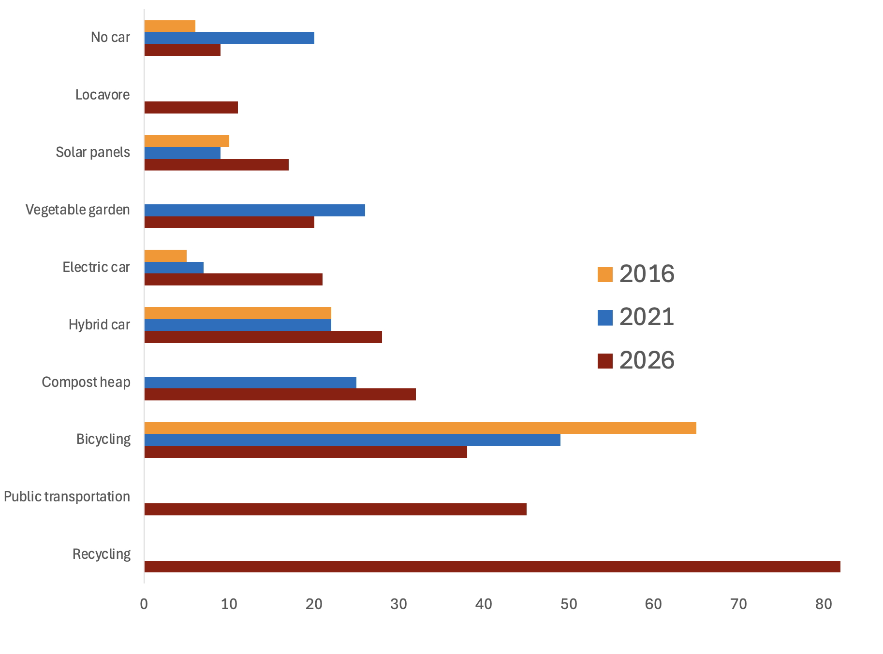
Which of these environmentally friendly choices have you made?

Slide 47
Avoiding plastics as much as possible
Heat pump, water heater heat pump, native pollinator garden, very little beef
Thrifting!

Slide 48
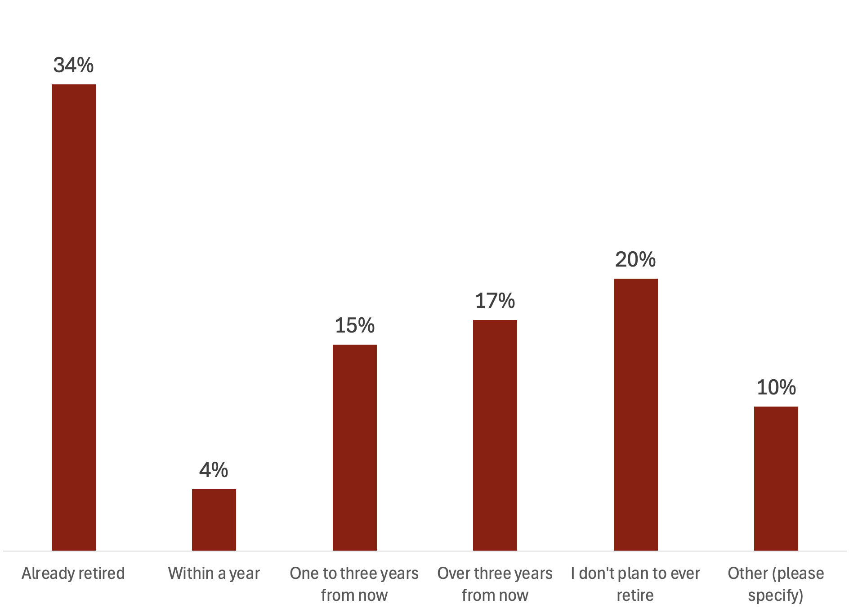
When do you plan to retire?
Notes:
Lots already retired, but a far number don't plan to retire...ever.

Slide 49
Failed first retirement, may try again. 😏
You rest, You RUST. I won't stop, just slow down.
I come out of retirement to give Reiki, Reflexology and/or Shiatsu treatments.
Notes:
Which classmte is this and can I have your phone number?

Slide 50

What do you want to do post-retirement?
Notes:
The next three questions deal more with us moving from the primes of our work lives to a next phase. It starts with question 23- what to do postretirement. Again I went to use a word cloud and the cloud does represent the answers pretty well. Travel was the overwhelming most common response, it was at least mentioned in over a third of the answers. Family featured commonly as well. It is worth mentioning that a significant number of people either hadn’t really broached retirement yet, didn’t have plans, or had no plans to stop working. There were also answers that were more sobering, for examples from classmates dealing with significant challenges, sometimes in terms of their own health and wellbeing, sometimes related to the health and wellbeing of a partner, friend or family member. This being Harvard, at least one person was finding retirement busy and challenging enough that they were already planning on retiring from it.

Slide 51
Learn what I didn’t learn at Harvard!
Relocate somewhere more sane.
I’d like to retire from my retirement.

Slide 52
What is your long-term residential plan?
Notes:
Our next question, 24 was relatively straight forward. Although the question was structured as open ended, the variety of responses was not as broad as some other questions, and it was relatively easy to categorize the answers as I did in the graph above. The raw numbers are on the y axis and so you can see it was a roughly even split between, downsize, stay put or undecided. There were some interesting additions to the questions (briefly go thru locations, a couple of the upsizers, reasons for moving and my favorite: God laughs at plans.

Slide 53
Downsize and move to somewhere warmer. Another country?
Less snow! Lower taxes! But still close to family.
“God laughs at plans.”

Slide 54
What changes in the world over the past 45 years have affected you most?
The double-edged sword of technological progress—internet, cell phones, and more
Social progress—and backlash
Trump and the rise of the extreme right
Fractures: socioeconomic, political, cultural
Higher-ed battles over ideology, content, control
Notes:
Double-edged sword of technological progress—Internet, cell phones & more
We marvel at tech– the personal computer, Internet, cell phone, AI–and the revolutions in communication & efficiency, like remote work and global connectivity.
But we’re disturbed about the side effects: Cell phone dependence, social media, misinformation, disinformation, un-critical thinking, careers made obsolete, social isolation.
Social progress–& regress– in LGBTQ rights & women's opportunities in the workplace, for instance.
Outweighing the remarkable progress are Trump et al. Any guesses on how many of us name him, MAGA, rising authoritarianism or democracy’s erosion? 90–at least one-third of us. It’s the single-most mentioned change. We’re despairing and stressed about the attacks on truth, the rule of law, science, civil rights, federal employees and diversity, just to name a few. Here’s one quote: “The current extreme-right backlash, including the complete loss of faith in the Supreme Court & our political system, has us questioning whether we want to stay in the US at all. And we see that extreme-right wave in many parts of the world. One step forward, 2 steps back.”
Fractures–socioeconomic, political, cultural Fractures include a loss of civility, of shared facts, shared norms, respect for the press, & trust in institutions. The widening wealth gap. Us vs. Them. Violence.
Higher ed Higher ed came up, too:
“The ideological takeover of higher education”
“The rejection of educational excellence in favor of normative groupthink.”
And: “I have been more proud of Harvard than I’ve ever been, for the way it’s stood up to the Trump Administration's corrupt political and financial extortion.”

Slide 55
Social media wants to eat my brain. I'm tempted to let it. But then I walk outside in nature and think, "This is better.”
I was living in Berlin and working as a nuclear engineer when Chernobyl occurred, and it definitely changed my approach to my field and started me on a career change. But it is the changes in the past 15 months in our country that have affected me most deeply in ways I wouldn't have expected at my age.
The realization that we're really at the mercy of the oligarchy, many of whom were educated at our alma mater and its peer institutions.

Slide 56
The two countries where I expected to feel the most safe—USA and Israel—are not safe and I am ashamed of the policies and practices of both. It is very disconcerting—at this age—to feel like I don't have a country anymore.
I am glad I’ll leave academia before AI utterly destroys it. Our students are already reading much less than they used to and using AI and Google instead of doing research….
I detest the loss of human connection resulting from gazing into little glass screens.

Slide 57
What has been most satisfying to you in your professional career?
Teaching and mentoring, inspiring the next generation
Advancing medical treatment in the US and abroad
Lawyerly accomplishments – helping and protecting people
Advancing technology – helping people, new understanding
Improving international relations
Improving the world, increasing sustainability
Adding to the sum of human knowledge
A job well done
Making a difference
Retiring!

Slide 58
The "aha" lightbulb moments when a student suddenly understands something.
Tangible signs that my research has added to scientific knowledge.
Relationships with people that carry on.
The moments when I could really bring the fun: it was a real high when the cards were flying and people were winning and tipping me like crazy.

Slide 59
Writing software that allowed paraplegic kids to play Nintendo.
Discovering and enabling others to discover new phenomena in the world that we just were not expecting and then had to try and explain.
Feeling as if by my professional choices I have made the world incrementally better.

Slide 60
What is one belief you had as an undergraduate that you still believe in now?
Top Themes:
Integrity matters.
Hard work pays off.
Kindness is key.
Notes:
For beliefs that we still hold: Only 3 answers were predominant. Wait til you see the next slide….

Slide 61
And what is one belief that you’ve let go of?
Arc of the moral universe bends toward justice
Intelligence and knowledge reign supreme
I’m right
That we live in a meritocracy
Goodness prevails
Death penalty: now oppose
Notes:
We’ve let go of a lot.
Arc of the moral universe: Many of us believed the arc goes toward justice, progress, betterment. Now, we see it’s bent the other way. We’d thought we’d see “the US have a female president.” Maybe troubles in the Middle East resolved. We believed “racism will wither away” and “fascism would never happen in the US.” Not now. Not in our lifetime.
Intelligence & knowledge reign supreme
I’m right: Because intelligence is everything, and I’m intelligent, I’m right–and certain and in control. Perfection is admirable AND achievable. “I was meant for greatness.” Cringe!
Meritocracy: In college, we thought Merit & individual effort determine outcomes.
We now recognize the role of luck, timing, who our parents happen to be, privilege, who we know. It’s a more humbled, complicated view of success. It’s also the view of Harvard political philosopher Michael Sandel, though his wildly popular “Justice” course was launched too late for most of us.
Goodness prevails: We’re disillusioned about goodness – that people (particularly Americans & govt officials) are generally good, and want to make the world better.
Nope, the Good Guys don’t always win. No longer do we believe in American exceptionalism.
Death penalty IF ASKED: A handful said they’ve become anti-death penalty. Unclear if they were neutral or pro-death penalty before.

Slide 62
Religion is the opium of the masses, per Marx, learned in Sociology 101.
I still believe we must keep fighting for truth and justice. We must keep getting into good trouble.
Still believe in: Veritas. Let go: the idea that homo sapiens have any intrinsic interest in veritas when it isn't to their own advantage.

Slide 63
That other people should necessarily be interested in what I’m interested in.
I've let go of thinking I needed to be some kind of genius imposing my ideas on others. Lately I've been interested in how light-handed I can be in interactions, following the flow.
I no longer believe that Donna Summer is the greatest singer who ever lived.

Slide 64
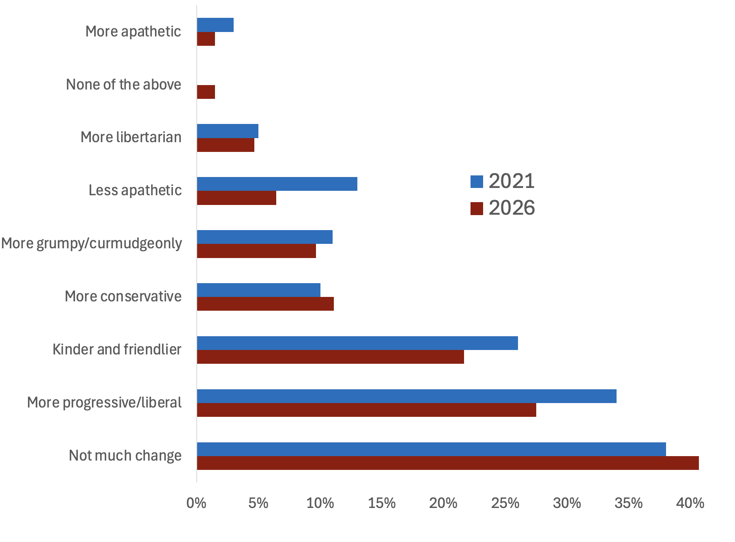
Since college, has your political perspective changed?

Slide 65
I am aiming to be a Curmudgeon - Andy Rooney is an inspiration.
I protest a lot more than I did as a college student!
More involvement in local matters--city, county, library or other boards for planning locally.

Slide 66
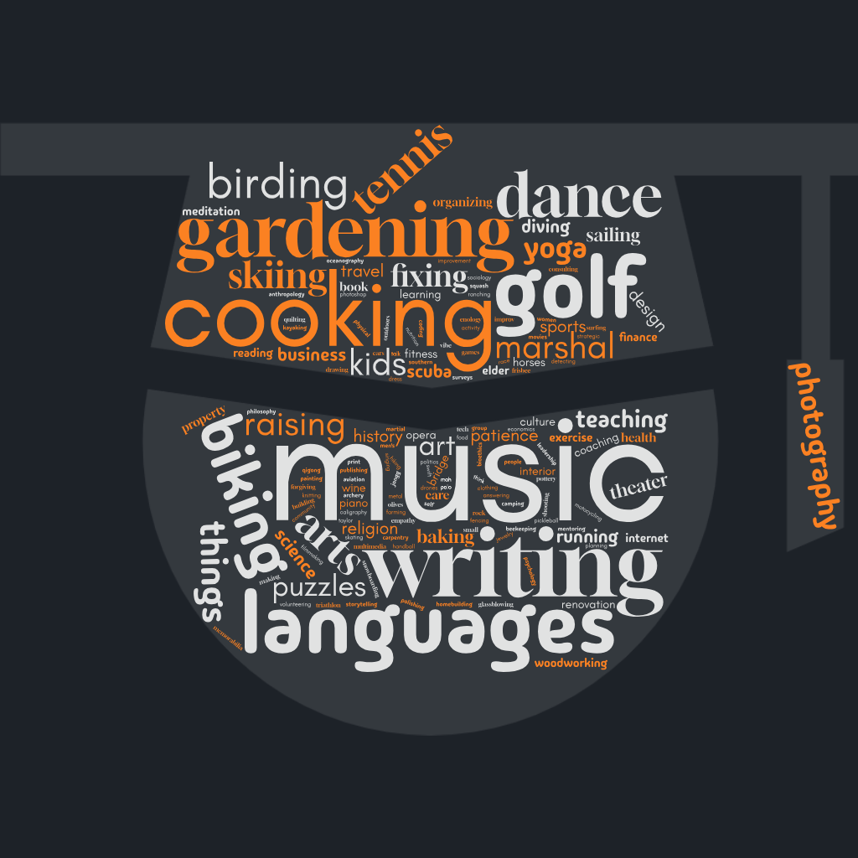
What new talent or interest have you developed since college?
Only one person said “Pickleball?!”
Notes:
The next question is also a little backwards looking, Q 29. I thought a word cloud could best illustrate this answer. The “winner” if there was such a thing was music with 28 individuals citing it, while cooking, languages, gardening, golf and gardening all had between 10 and 20 responses. As you might expect from a group like this, there was a huge number of disparate responses, from opera to archery, drones to rock polishing. However, there was at least one thing that didn’t completely ring true- only one person admitted to pickleball.

Slide 67
What’s on your bucket list these days?
Travel
Writing
(Re)Learning/Mastery
More family time
None of the above
Notes:
As 1 classmate said to the Bucket List question, “Hoping to get some great new ideas from everyone else at the reunion.” – So, listen up!
TRAVEL is far and away the #1 answer. It’s named by ⅔ of us, and often exclusively. Hottest destinations: Patagonia, Japan, Antarctica, Africa, New Zealand, Italy, France.
For Bucket-list travel, several classmates use Checklists: Visit the 50 states. All 63 national parks (did you know there’s 1 in American Samoa?). All Canadian provinces. Games at all MLB stadiums. The 4 tennis Grand Slams. Reach 100 countries.
Other travel niches: DIRigible travel. Quarries in Africa. Safaris in Africa–by horse. Total eclipses. Space.
WRITING is popular, too– writing about travel, for one. Also poetry, columns, memoirs, scripts.
(Re-)learning, mastering We want to learn or improve Banjo playing & bass fishing, Arabic, Latin, & Romance Languages, and surfing. Master quantum mechanics & general relativity.
Family-wise, we’re focused on grandchildren– we want them, and wanna hang out with them.
None of the above There are Outliers among us, of course: People who say they’ve completed their lists. Or don’t have one. Or everything they do seems to be on the list. Or they list things they don’t plan to do–the Unbucket List.

Slide 68
Restoration of a compassionate, multiracial, functioning democracy! Everything else I can live without.
Trump gone, followed in quick succession by Stephen Miller, J. D. Vance, and Pete Hegseth. Also, some travel and learning to play trumpet.
Living healthily till I'm at least 90 and then dying in my sleep with a smile on my face.

Slide 69
What is the biggest challenge you face these days?
Notes:
The next question is probably the most poignant of the ones that I handled. It’s also the one where my interpretation probably takes the most liberties. I thought categorizing the answers was probably the best route to take with this but there is no question that it probably meant that my interpretations could have altered the characteristics of the answers. That being said…..(go thru the figure). I hope that categorizing in this way doesn’t overly distract from some of the challenges facing classmates. As such I chose four responses to highlight: ( go thru the four responses)

Slide 70
Learning to age gracefully.
Loneliness.
Keeping up friendships even though I prefer solitude.

Slide 71
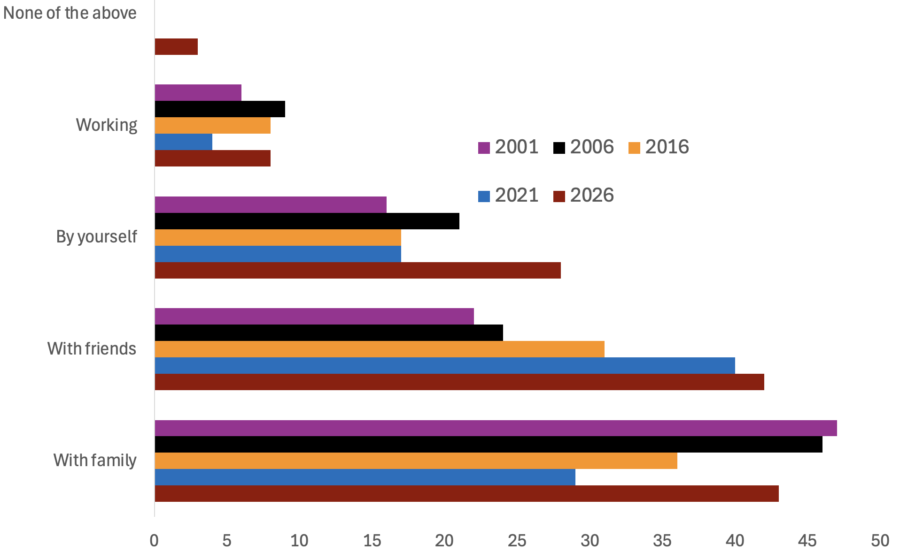
How would you spend an extra three hours a day?
Notes:
The distribution has been pretty steady over. I wonder if the switch between family and friends in 2021 was because we we seeing too much of our family?

Slide 72
I’d say 45 minutes of each of those options sounds
about right.
Reading. 📖
Disconnected from the Internet!

Slide 73
What is the most important thing you have learned about life in the past 45 years?
We were all over the map on this one, so you just get a bunch of our quotes!

Slide 74
That phrase that my mother told me as a kid is true - "When you are fighting a just battle against great odds life is exciting!!"
I’ve got a lot more to learn, and I’m excited about that.
I need more bookshelves.

Slide 75
Comparison is the thief of joy.
Listen.
Be kind.

Slide 76
What’s the one thing you wish you could tell your college self now?
Top Answers:
Relax. Breathe. You can do this.
You’re good just as you are.
Believe in yourself.
Fortune favors the bold.
Be more open-minded.
Listen more.
Notes:
There were so many wonderful, well-considered responses to this one. The most common: telling our younger selves just to relax and breathe into the moment and it’ll all work out. There were also many variants on self-acceptance acknowledging our self worth. Things I think maybe some of us still struggle with a bit today. There were also multiple reminders to be less rigid in our thinking, and to stop talking and just let other people’s ideas in.
And here are a few great quotes from you all….

Slide 77
Ask for what you want. Including that date.
You’re not the smartest person in the room.
Ask more questions.

Slide 78
Actually, the world is not your oyster.
Go to law school.
Don’t go to law school.

Slide 79
What would your college self be most surprised to learn about you today?
Shifts—career, location, personal
Relationships—mostly happy ones
Relaxed & comfortable in our own skin
That we’re still here!
Notes:
Shifts–career, location, personal
Our 21-year old selves would be surprised, if not dumbfounded, by several things– like our careers: We did or did not become a professor. We became a tax consultant (and even found it “rewarding & exciting”!). Or an elected official. A surgeon. A shaman.
Geographically, a handful surprisingly returned to their hometowns– and for one classmate, less than a mile from their childhood house. There’s expats, rural townspeople, and a Mainer.
A few classmates went from shy to public speaking, reporting, or organizing political protests.
One went from devout atheist at Harvard to Bible Study teacher and Methodist choir leader. A couple of people shifted right politically.
Relationships, and particularly our happiness in them, have often been surprising– I got married, or stayed married for so long. I enjoyed motherhood, love grandparenting. I’m single & thriving.
Relaxed & comfortable in our own skin We’re less competitive, if not downright unambitious. We admit we’re vulnerable and need help. We’re happy not because of our achievements & prestigious credentials, but because of friends, family & purpose.
So, show of hands: Who’s gotten over imposter syndrome?

Slide 80
That I ended up in Minneapolis living a rather ordinary life, without the glory and fame I had envisioned.
The degree of contempt I have for my college self.
You will give up on wearing all colors but black. You will move down South and stay down South.

Slide 81
That not believing in God has made me kinder and more empathetic and just as spiritual. That I was in a closet and came out of it. That the love of my life was a cat….
That I am the President of a local garden club. My mother made me help in the garden as a child, so I hated it. The peace and satisfaction that come with working in dirt was not imaginable in my college years.
That I married my first love when I was 60!

Slide 82
What else would you like to tell your classmates?
Top Themes:
I wish I’d gotten to know more of you!
Be kind. Be brave.
Remember how lucky we are.
You are amazing people!
Thank you.
Notes:
At the end of our survey, we asked you all if there’s anything else you’d like to say to your classmates. We got one business promotion (you know who you are), and one person who said they wouldn’t presume to know what their classmates might want to hear. But many of you spoke from the heart. The number one answer: wishing it had been possible to meet and hang out with more of our 1630 classmates during our four years together. Also, a lot of good reminders for navigating this world. And more than one simply said “Thank you.” Which seems to make this a good time for us to say thank you to all who took the time to respond to our survey, and to all of you for sharing in the results with us today.
Now it’s time for prizes!

Slide 83
I hope you live the rest of your life with joy.
You’ve all gotten nicer as you’ve gotten less competitive.
My classmates are the best gift that Harvard gave me.

Slide 84
I have a guest room on the main floor.
Remember the meaning of Veritas.
I’m glad we’re still on this ride together.
Notes:
To the classmate with the guest room: we just need to know where you are, and when we should arrive.

Slide 85
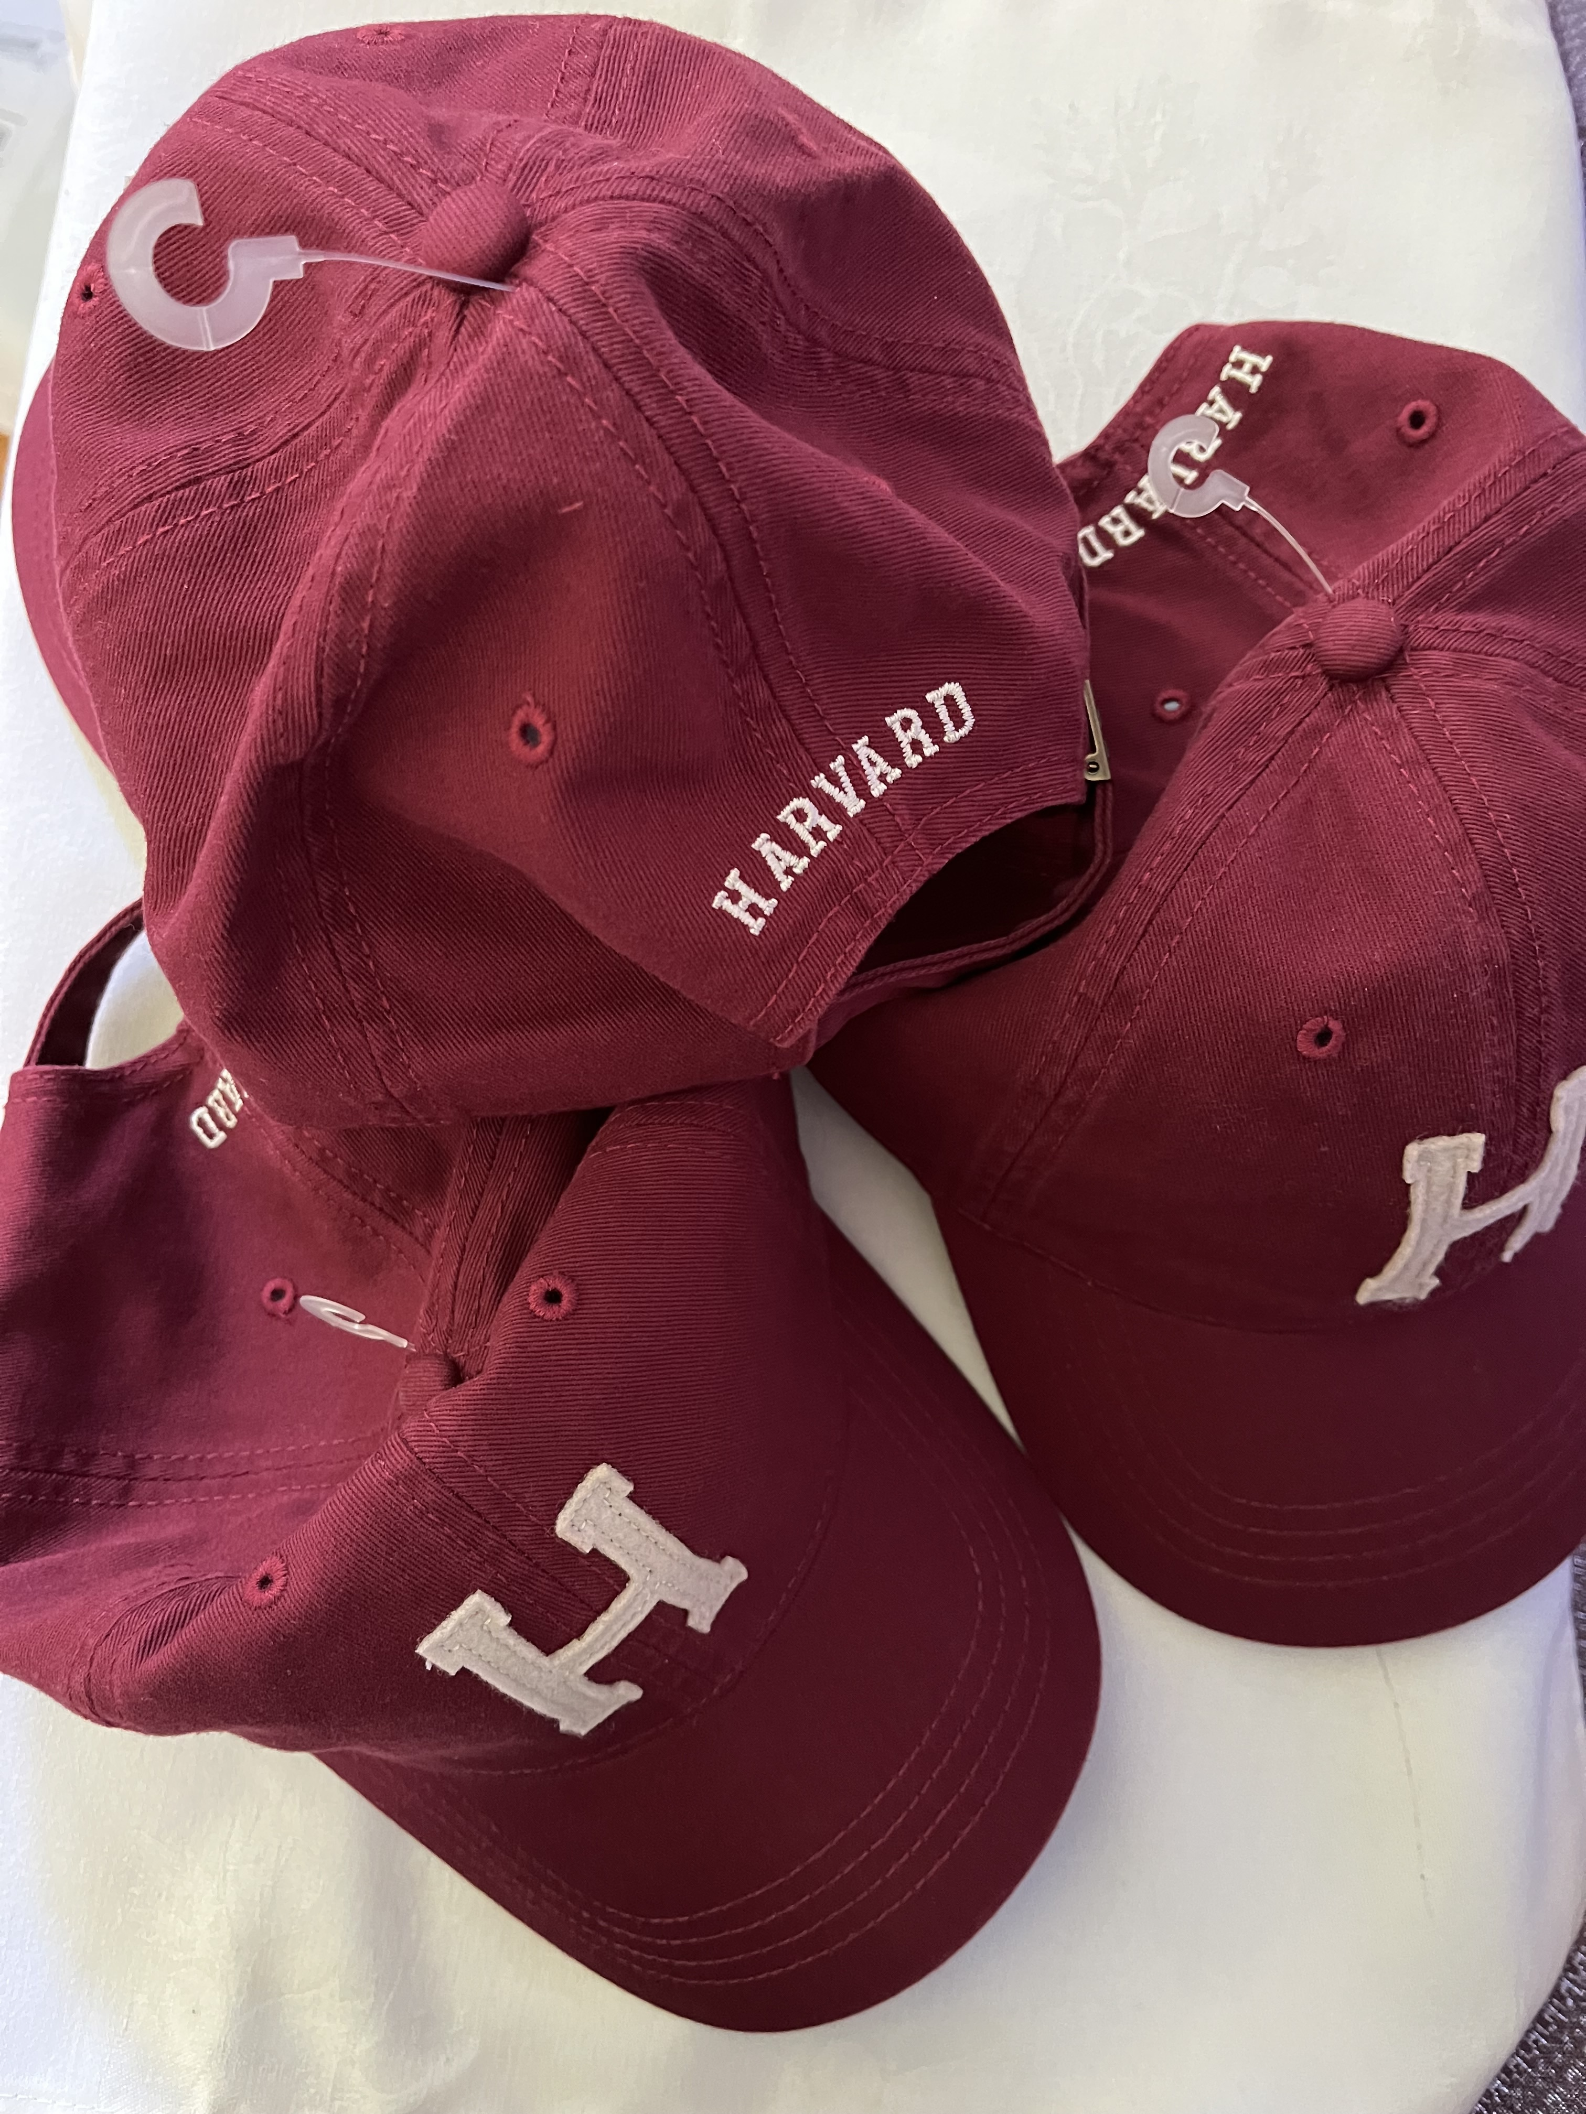
And Now…
Our Three
Random Drawing Winners!
(Winners: Please see Hilary afterwards)

Slide 86
Final thoughts
We did ask you all one more question. We asked what you wanted on your tombstone or urn. How you’d like to be remembered. We received such a great mix of funny and poignant and sincere responses it didn’t seem possible to do them all justice in a couple of slides. But Jim got creative and made a closing sequence for us that will let people’s responses scroll by. Here’s to Harvard’s Class of 1981!

Slide 87
What do you want on your tombstone/urn?
as a kind person who demonstrated honesty and integrity. someone who remained intellectually curious.
I would like to be remembered as someone who was enthusiastic, brought positive energy, and cared about people.
someone who tried to do his best at whatever he did; who worked for justice; fulfilled commitments and cared for others; a loving husband and a good friend; who was kind and funny; who sang.
I’m not sure I care about being remembered except by my kids though I expect a couple of my books will last
I’ve been told that my tombstone should say “I told you so…”In reality, I’ll be cremated and won’t have a tombstone
I'd like for my daughters to have a present sense of having been deeply loved and supported.
I'm not sure I will have accomplished anything generally memorable. The best way to be remembered would be in the reminiscences of those who love me.
Imperfect lover of God and fellow humans.
Improved the world for others through my work as an architect
independent thinker
John lived life like it would end tomorrow and was amazed that it didn't.
Kind
Kind and supportive person
Kind, caring and friendly.
kindness, graciousness, curiosity, loving, smart
Legacy of public service
Thoughtfulness
too early for that!
Took good care of his family. Did what was right.
Touched others' lives, made the world a little better with her light
tried to help when i could
truthseeker and truthteller; resilient and restorative
Urn? Ashes? Can't I just decompose...naturally?
USMC
valued family and community, a righteous person
Was there for others.
We are all broken, some more than others. Despite all my imperfections I tried to be a good person.
Well he was pretty amusing
What? Am I sick and don’t know it?
when loved ones had a physical/emotional crisis, I always showed up
While he often fell short, he tried to live a worthy life, an examined life.
Who knew that at 180 you could still be fabulously handsome, sharp as a tack, strong as an ox, and beloved by all.
philanthropist
prefer not to be remembered, and will not be
rather not think about that just yet!
Raymond Carver put it best in his poem "Late Fragment": "And did you get what/ you wanted from this life, even so?/ I did./ And what did you want?/ To call myself beloved, to feel myself/ beloved on the earth."
Reliable and present
Remembered: as kind and supportive. Inscription: Don't care. Whatever pleases my survivors.
Rob brought people together.
Selflessly gave to his family and community.
Settled, calm, contribution to community, and a smile for all. No urn - scatter me.
She cared
She did the best with what she had.
She helped the under-dog
She inspired us to be our best
She kept looking
She lived her soul’s magic.
She loved deeply and fiercely and those she loved knew they were loved.
Thanks -- from the whole world -- for being willing to leave ABSOLUTELY EVERYTHING, EVERYWHERE so the world could could better and more alignedly heal itself.
That I cared, and did my best to help others.
That I grew to be thankful for all that God gives to us.
That I made a difference
That I took care of a lot of people, act e as the patriarch for a very extended family, and did a t gladly.
That I was a good father, husband, and friend, that I loved to laugh and make others laugh.
That I was a good husband and father; that I was creative and left something of value with my company
That I was a great foul-weather friend, parent, spouse, daughter, sibling
That I was an empathetic person who truly cared about and loved those who were close to me.
that i was an intelligent, caring, sincere person
That in myriad small ways, every day, I made the world and those in it a better place, through my kindness, my smile, my ability to see the good in every person and every dog
The best Welcome Desk lady at church, a great mom and grandmother
The family tradition is just dates. Maybe “at peace” as that would be comforting to the reader.
Jackie Robinson once said: "A life is not important except in the impact it has on other lives." I have tried to take this to heart in my own life, I hope I am remembered for a life of service.
This is not important to me. More important is how good am I at leaving according to my ideals.
She loved her children and family, she improved the land in her care, she supported others in their dreams.
She outlived us all.
She tried to be a better person
She tried to be kind and fair
She tried to make a difference in the lives of others.
She was a kind person
She was a loving, giving individual
She was happy and tried to make others happy.
She was kind to all
She's not dead yet
Someone who did a wide variety of things, risked failure, discomfort to try something new, challenging. A mother whose actions and choices demonstrated fierce love for her daughters.
Someone who gave a smile and gave of his talents and joy in life freely
someone who helped her family and friends
Someone who tried to help humanity.
Someone who was loyal to friends and family and kind to all
like a former boxing champion had on his tombstone: You can stop counting, I'm not getting up! On more serious note, he was a man of God and a good friend, and he loved people well!
LIving life to its fullest
Loving Spouse and Father...Incredibly loyal/supportive friend
Loving spouse and parent
Loving wife, proud mother and good friend
Made a positive impact on family, colleagues and students
my dates (1959-???): She believed in dates
Never give up, never surrender
No tombstone, don't really care about being remembered. But, I hope that I have inspired people during my lifetime.
None of your business
Nothing came easy but it worked out in the end
omg, I refuse to answer that; I am SUPERSTITIOUS
One of my favorite aphorisms: "When in doubt, know everything."
Party On!
Peacemaker
Person with integrity who cares about others
"David was not normal” is the opening line of my death notice. Where it goes from there is still being written.
"Find this mortal world enough." W. H. Auden
"He Cared -- And Always Did Something About It"
"He danced to the music even when he couldn't follow the lyrics"
"He helped me be my best me."
"He loved someone very much, and they loved him back. That's a life well lived."
"It's always the right time to work for peace and justice."
"Saw trees. Forest, not so much…Are you listening?!"
"She lived thoughtfully, led generously, and never stopped learning."
"She made the world a better place"
"She was kind, creative, and incredibly well organized."
"True of heart and firm of will, he stood against the darkness, and kept faith with those he loved."
A friend to all
A fun person
As someone who cared about others
As someone who cared about others well being and hopefully helped them along their journey in life
As someone who cared about others.
As someone who cared about people and made things better
As someone who grew up, reached out to people, helped them, individually and closely
AS someone who loved life, deeply cared for others, was extremely passionate about the arts and savored nature's grace and fury
As someone who paid it forward.
As someone who sought to improve the lives of young people in Africa
As someone who tried to be fair, open, and honest; who generally tried to do the right thing; and was able to succeed anyway.
As someone who tried to help others, especially those who have been marginalized by our society
as someone who tried to make the world a better place
as someone who tried to make the world a better place, mostly in small ways
As someone who tried to make the world a little better bit by bit, and who in personal relationships made people feel better about themselves.
As someone who was a good listener and who always tried to be helpful to others.
As someone who was kind and tried to help others
For my creative work.
For my tombstone: "To All Who Come To This Happy Place, Welcome." -- Walt Disney
For trying to live up to that value and occasionally succeeding
gave service with least rewards and appreciated the power of small events in the very least supported
Generous in spirit and all else
Good family man, loved his family.
Good father, good husband, good doctor.....a good man
Good father, husband and friend
good father, husband, brother
Good friend, brother, son, husband and father.
Good neurosurgeon and husband and father.
Grandfather, father, brother, uncle
Great dad, decent husband, kind, smart, fun, sad
Great husband, father, friend. Helped others
Great mom and friend
a good father and husband
A good father and husband and a filmmaker whose work reached people and changed their minds on occasion.
A good friend, an honest person who tried to do the right thing
A good husband and father
A good listener
a life well lived -- with kindness, exploration, and generosity
A loyal friend, a visionary, someone who brought hope.
A person who worked for social justice and equity in society.
A thoroughly nice guy and a good citizen of the Republic
Absolutely do not care
Advocate
Always caring, always curious.
Always seeking VERITAS; Curious until the end.
And did you get what/you wanted from this life, even so?/I did./And what did you want?/To call myself beloved, to feel myself/beloved on the earth. Late Fragment Raymond Carver
As a good child, husband, father and friend
as a good father/grandfather/friend
as a good friend and inspiring mother
As a good friend.
As a good person
As a kind and loving person
As a kind person who loved and supported those dear to me and expressed my love for them often.
As a loving person
As a loyal friend who cared about others and worked hard to do her best with opportunities and challenges
As a nice person who was good to his family and helped others
As a problem-solver who tried to make things better
As a star NHL hockey player. Unfortunately, I will have to satisfy myself with hoping I made a positive difference in the lives of people I connected with, and that they will remember me fondly, happily, wistfully, and with some joy and appreciation.
As an enthusiast: about life, learning, experiencing.
As one who contributed to understanding of our obligations to each other
As someone that made others feel good
As someone who cared about and helped others
he'll be missed
Here lies one who gave of herself.......
Honest dependable kind
Honest, dependable, high integrity; committed to relationships;
Huh, not something I think about
Humble, brave, generous and teachable.
Husband, father, son, brother, writer, organizer, lawyer.
I can imagine being quickly forgotten. I wish I could have had more impact.
I don't have a desire to be remembered. I just hope I will have done my part to make things better.
I don't need a legacy but I hope that people I cared about thought I was a positive force for good in their lives.
I don't need to be remembered. This life is enough.
I guess I'd like to be remembered for responsiveness to the Holy Spirit. On my tombstone? A death date for my husband many, many years from now, and my own close to the same time.
I helped make the world a better place.
I hope the younger rememberers will carry my encouragement forward. On a marker, an indication that I went through life partnered to my wife.
I loved and was loved
I loved my friends and took lots of pictures
When nobody else is acting with basic human decency, you must strive to be the one who does" במקום שאין אנשים, השתדל להיות איש my love for my family
I stayed connected to my family and friends.
I think I'd most like to be remembered as a caring person who had a sense of humor.
I told you I was sick
I want to be cremated. My legacy will be my scholarship and any help I provided my students.
I was lucky enough to love and be loved.
I was truthful, kind, loving, and fair
I would like my books to continue to be read.
I would like people to remember that I was happy with my life.
I would like to be remembered as a good daughter, niece, sister and aunt. I did my best to stabilize my family through various crises when help was needed.
I would like to be remembered as a kind and thoughtful friend.
I would like to be remembered as a kind person who demonstrated honesty and integrity. I also want to be described as someone who remained intellectually curious.
As someone who worked hard to help everyone be the best they can be
As someone who worked with integrity and purpose but always had time for others
As someone with an independent spirit who gave it all she had
As someone you could count on, a friend in need. A loving husband and father. That's enough for me.
At least I tried
Beloved and good son, husband and friend
Blessed abundantly, he strove to make life better for others because it is good and possible
brought joy and wonder
Charitable, caring
Daughter of…
Enduring friend, inveterate bon vivant.
Eww.
Faithful and loving
follower of Jesus Christ & lover of people
for any ways in which I helped make someone else happier
Had a positive effect on others+
have done good
He always showed up
He contributed to the stock of knowledge in a meaningful way
He did his best to live a full life and help others to live theirs.
He discovered a practical fusion technology. No one cared.
He entertained and informed
he fought the fascists to the end
He had fun and he helped others do the same
He helped humanity.
He helped people
He left the world a better place
He loved sports especially football 🏈
He made a difference in other people's lives
He made me laugh and cry
He made the world a better place. He was the most dedicated and loving father to his daughters
He made us smile
He stepped up, he done good.
He tried a lot, he succeeded some
He tried his best to make the world a better place
He tried to support good in the world and always worked on being a better human being.
he tried, anyway...
He wanted to live forever
He was a good man
He was a good person.
He was enjoyable to be around
He was fairly true to his principals and mentored many aspiring to have careers in energy finance
He was faithful to his calling
He was honest and loved his family
He was kind.
“With Love”

